Slide 1

Conscience & Moral Decision Making

Slide 2
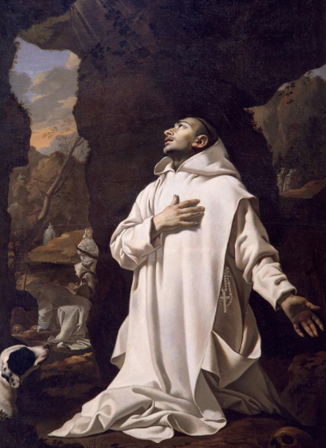
Conscience
What is Conscience?
Guilt or Guide?
Perfect or Imperfect?

Slide 3
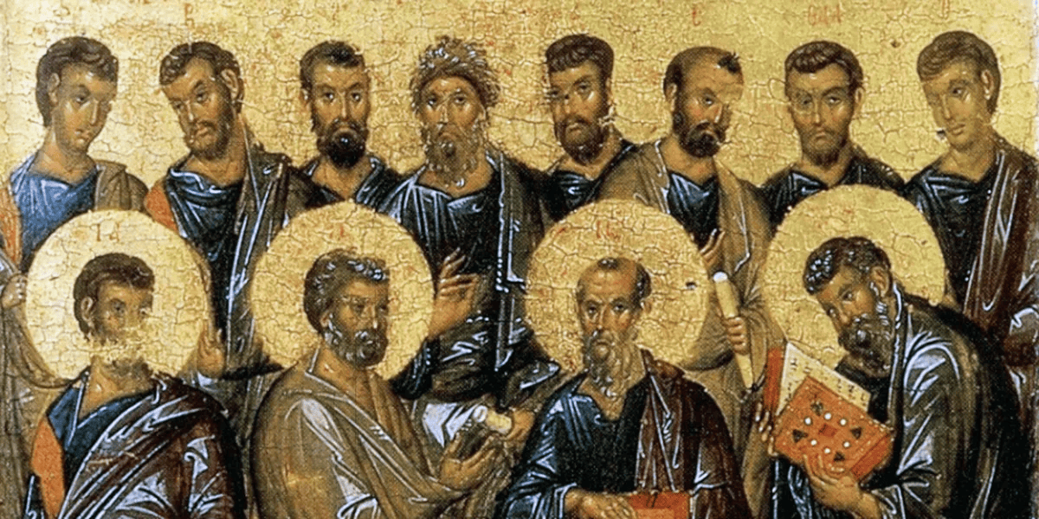
Vice of Deficiency
Vice of Excess
Virtue

Slide 5
Two Ways: Life and Death
There are two ways, one of life and one of death, but a great difference between the two ways. The way of life, then, is this: First, you shall love God who made you; second, love your neighbor as yourself, and do not do to another what you would not want done to you. And of these sayings the teaching is this: Bless those who curse you, and pray for your enemies, and fast for those who persecute you. For what reward is there for loving those who love you? … In the church you shall acknowledge your transgressions, and you shall not come near for your prayer with an evil conscience. This is the way of life.

Slide 6
Two Ways: Life and Death
…, you shall not murder a child by abortion, … You shall not be double-minded nor double-tongued, … you shall not be covetous, … you shall not hate any man …
And the way of death is this: First of all it is evil and accursed: … adultery, lust, fornication, thefts, idolatries, magic arts, … boastfulness; persecutors of the good, … not cleaving to good nor to righteous judgment, watching not for that which is good, … loving vanities, pursuing revenge, not pitying a poor man, … lawless judges of the poor, utter sinners. Be delivered, children, from all these.

Slide 7
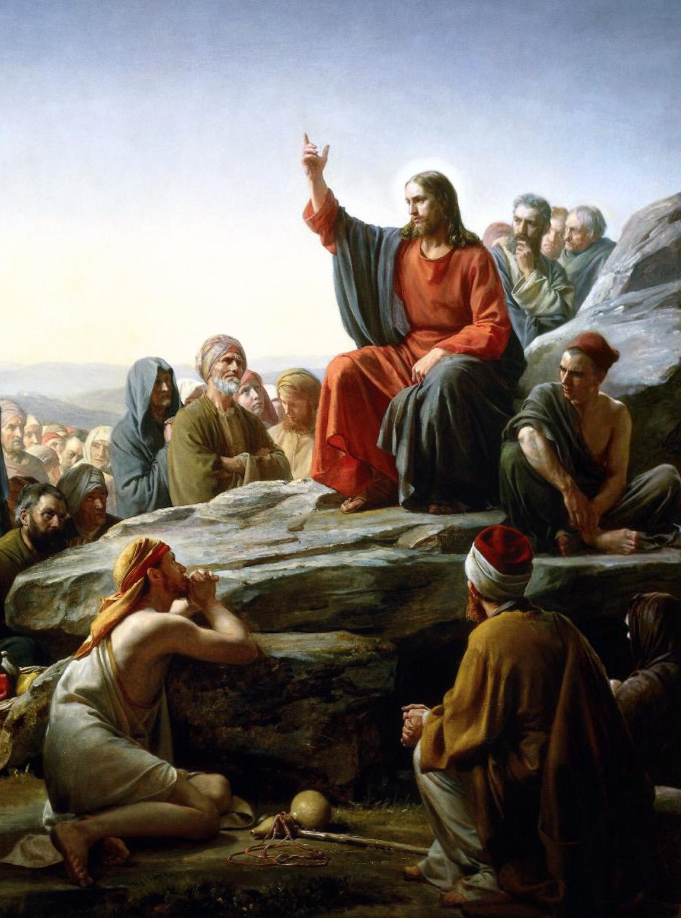
Anatomy of a Moral Act
See CCC 1755
Object (Matthew 5:28)
Intent (Matthew 6:3-4)
Circumstances (Luke 10:25-37)

Slide 8
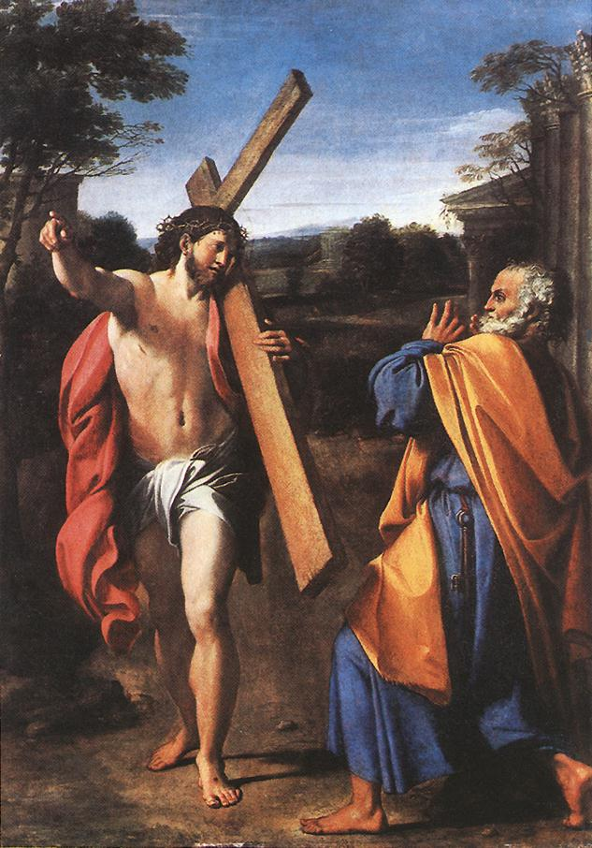
The Hard Parts
What does it mean to be salt?
Virtue is hard
Not a weapon against others
Justice (1 Corinthians 10:24)
(Luke 12:13-15)
Notes:
The world teaches easy virtues, don’t fall into acceptance

Slide 9
Thank you!
Questions?

