Slide 1
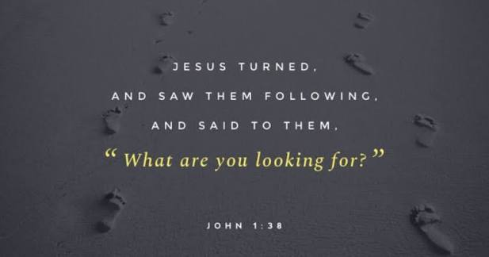
The Desire for God: OCIA 8/11/26

Slide 2
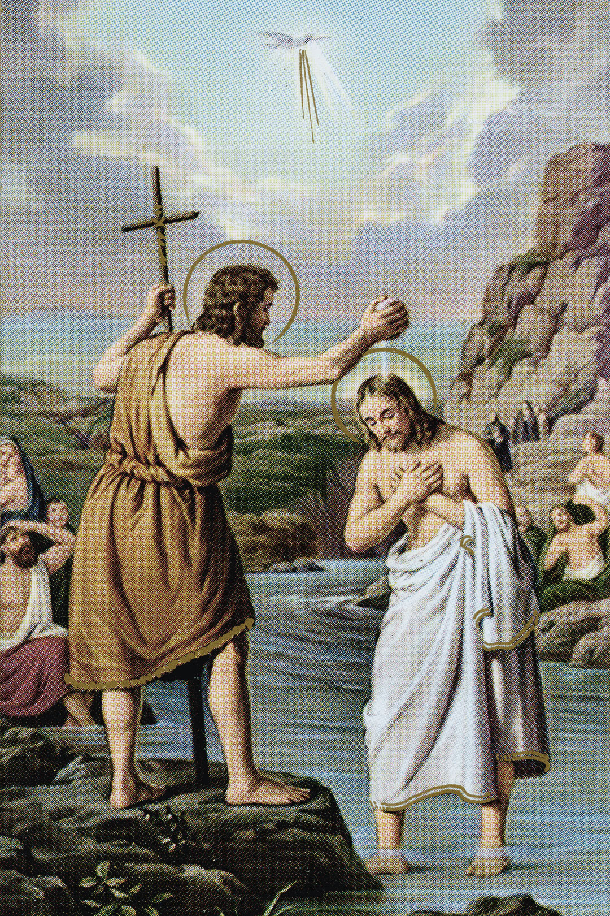
Opening Prayer: John 1:35-39
³⁵ The next day John again was standing with two of his disciples, ³⁶ and as he watched Jesus walk by, he exclaimed, “Look, here is the Lamb of God!” ³⁷ The two disciples heard him say this, and they followed Jesus. ³⁸ When Jesus turned and saw them following, he said to them, “What are you looking for?” They said to him, “Rabbi” (which translated means Teacher), “where are you staying?” ³⁹ He said to them, “Come and see.” They came and saw where he was staying, and they remained with him that day. It was about four o’clock in the afternoon.

Slide 3
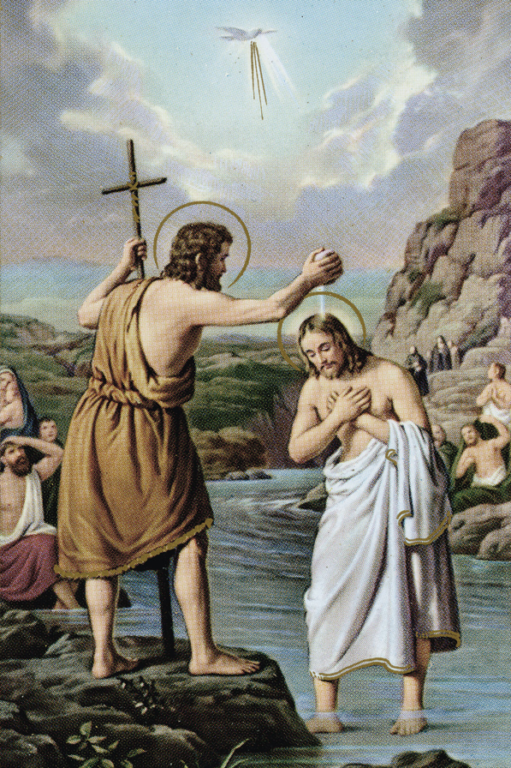
Reflection/Discussion
How did the disciples respond to Jesus’s question?
What are they looking for?
How would you have responded?
Any other thoughts about anything that stood out to you?
What do you think God wants you to hear as a result of having encountered this passage.

Slide 4
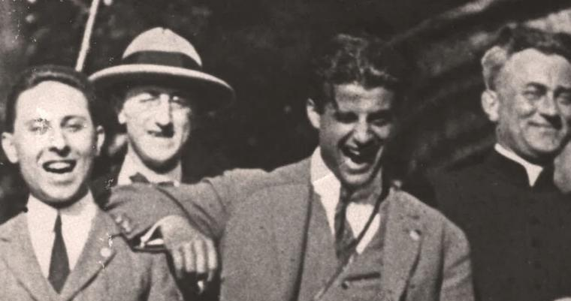

Happiness vs. Joy
A time in your life where you felt true authentic happiness. And you wanted to stay there forever.
In our nature to desire the good.
It comes and it passes.
We desire a complete joy.

Slide 5
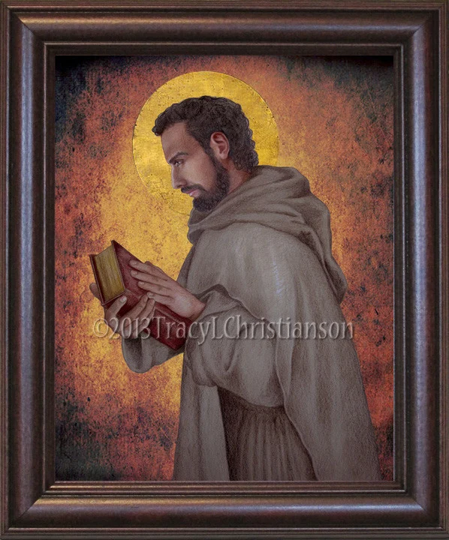
What are you looking for?
What is your deepest desire?
Power
Pleasure
Success
Popularity
“You have made us for yourself O Lord, and our hearts are restless until they rest in you”

Slide 6

The Catechism of the Catholic Church:
Paragraph 27:
“The desire for God is written in the human heart, because man is created by God and for God; and God never ceases to draw man to himself. Only in God will he find the truth and happiness he never stops searching for.”
What does God desire?

Slide 7
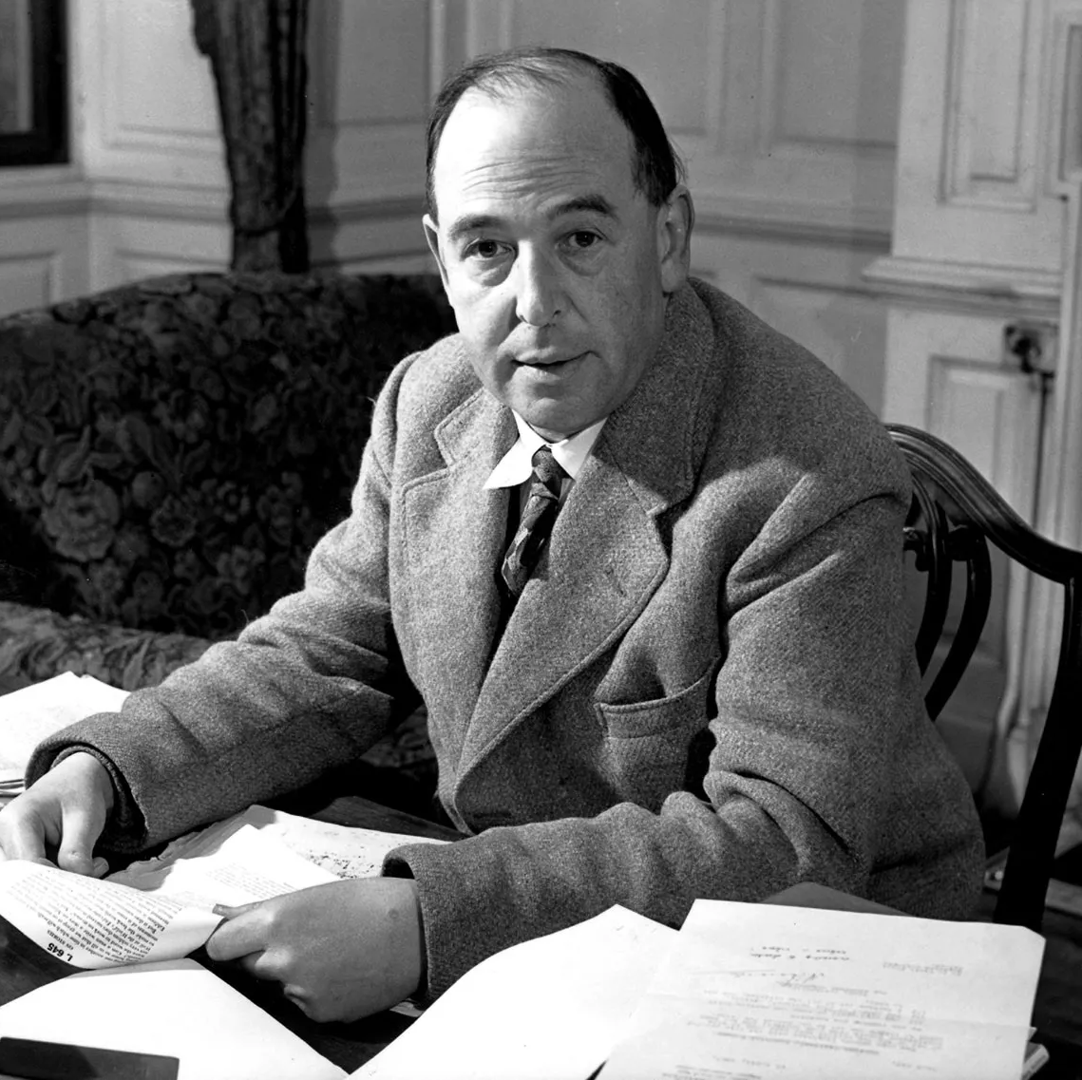
C.S. Lewis
“I find in myself a desire which no experience in this world can satisfy, then the most probable explanation is that I was made for another world.”

Slide 8
The Catechism of the Catholic Church:
Paragraph 27:
“The desire for God is written in the human heart, because man is created by God and for God; and God never ceases to draw man to himself. Only in God will he find the truth and happiness he never stops searching for.”
What does God desire?

Slide 9
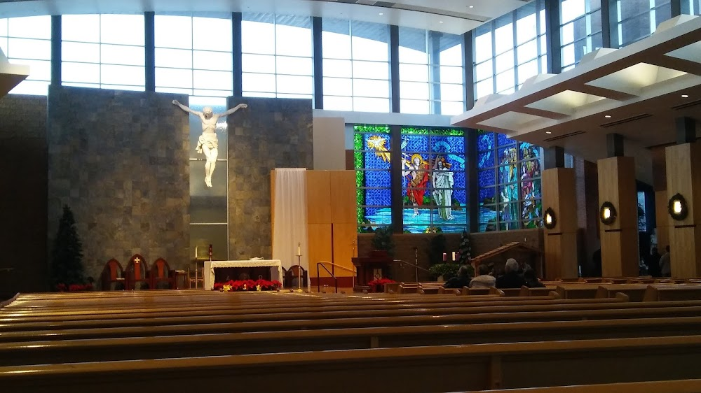
Story

Slide 10
Small Group Discussion
What experiences of joy have led you here?
In what ways has God given you a sense of peace or joy? (obvious or not so obvious)

Slide 11
