Slide 1
The Liturgy of the Eucharist Parts 1 & 2

Slide 2
Review
2
The Introductory Rite
The sign of the Cross
Greeting: “The Lord be with you”
The confiteor
The Kyrie “Lord have mercy!”
The Gloria and Collect
The Liturgy of the Word
First Reading (usually from the Old Testament)
Responsorial Psalm
Second Reading (usually from an epistle)
The Gospel reading
The Homily
The Creed
The Prayer of the Faithful

Slide 3
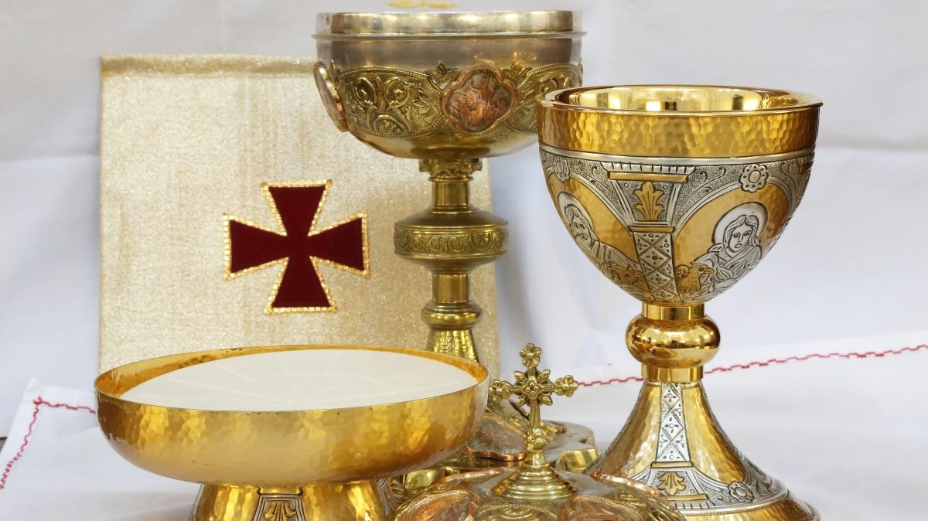
What is the Liturgy of the Eucharist?

Slide 4
The Preparation of the Gifts
This is not Mass half-time.

Slide 5
Break
5

Slide 6
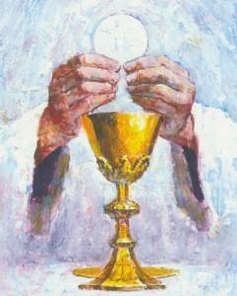
The Eucharistic Prayer
This Photo by Unknown Author is licensed under CC BY-NC-ND

Slide 7
The Jewish Passover had very specific parts
Barakah (blessing)
Haggadah (retelling of the story of how God had saved them)
Second barakah (near the end of the meal)
The second barakah had 3 distinct parts:
Praise of God for His creation
Thanksgiving for His redemptive work in the past
Supplication for the future

Slide 8
The Preface
“The Lord be with you”
“And with your spirit”
“Lift up your hearts”
“We lift them up to the Lord”

Slide 9
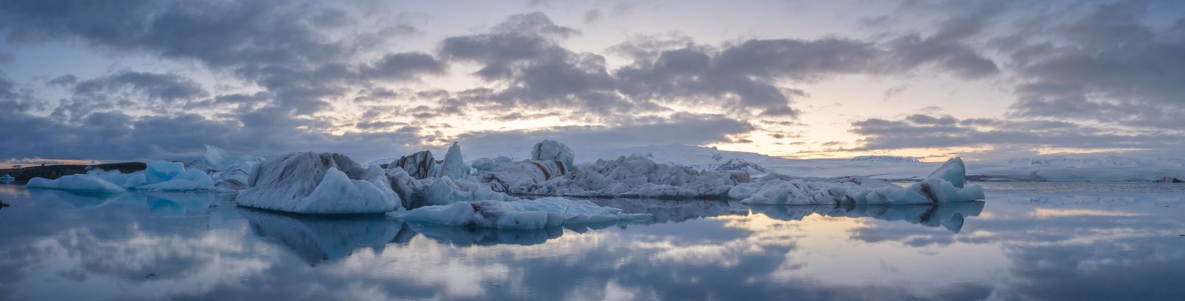
“Let us give thanks to the Lord our God”
“It is right and just”

Slide 10
The Sanctus
“Holy, Holy, Holy Lord God of hosts. Heaven and Earth are full of your glory. Hosanna in the highest. Blessed is he who comes in the name of the Lord. Hosanna in the highest.”

Slide 11
The Epiclesis
“Therefore, O Lord, we humbly implore you: by the same Spirit graciously make holy these gifts we have brought to you for your consecration, that they may become the Body and Blood of your Son our Lord Jesus Christ.” – Eucharistic Prayer III
“Make holy, therefore, these gifts, we pray, by sending down your Spirit upon them like the dewfall, so that they may become for us the Body and Blood of our Lord, Jesus Christ.” –Eucharistic Prayer II

Slide 12
The Words of Institution and Consecration
“Take this, all of you, and eat of it, for this is my body, which will be given up for you,...”
“Take this, all of you, and drink from it, for this is the chalice of my blood, the blood of the new and eternal covenant, which will be poured out for you and for many for the forgiveness of sins.”
“Do this in memory of me.”

Slide 13
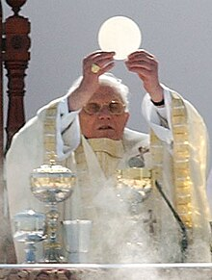
The Mystery of Faith
“We proclaim your death, O Lord and profess your Resurrection until you come again.”

Slide 14
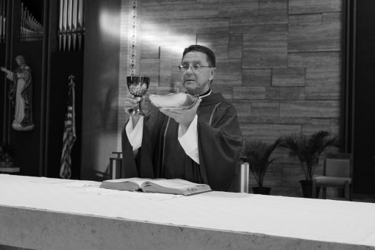
The Anamesis The Offering The Final Doxology

