Slide 1
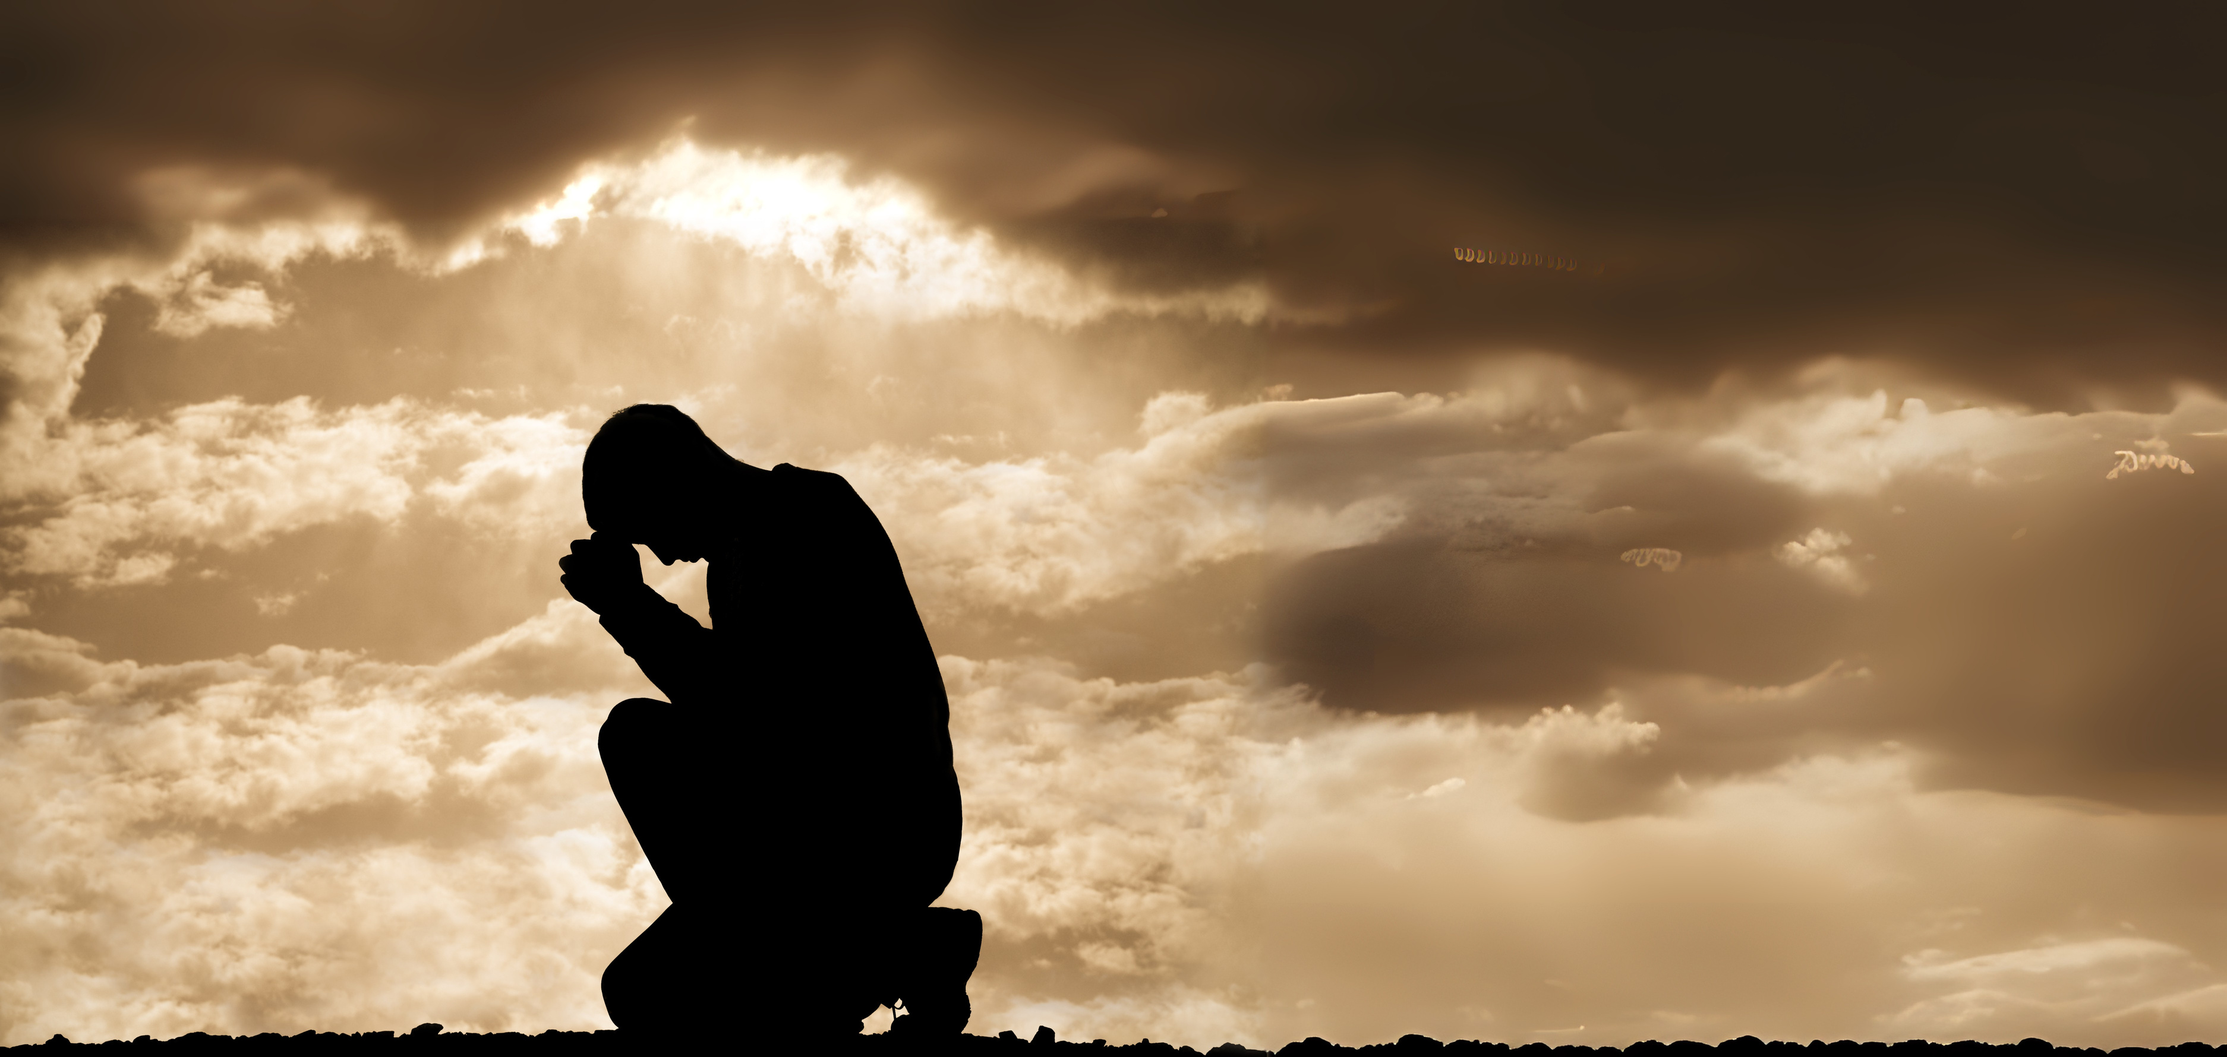

PRAYER
What is it?
How do we pray?
What are the different types & forms of prayer?

Slide 2
WHAT IS PRAYER?

Slide 3
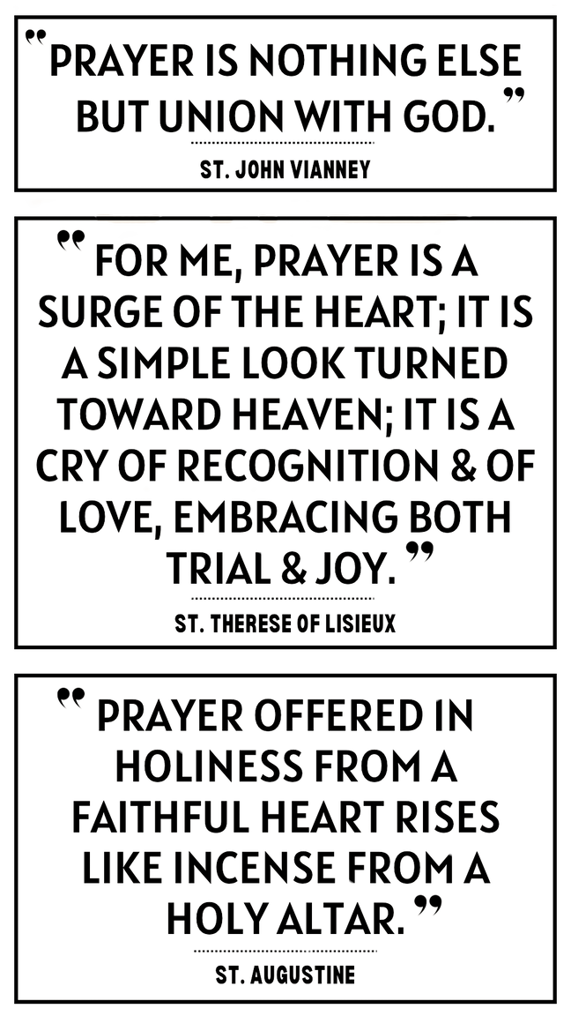
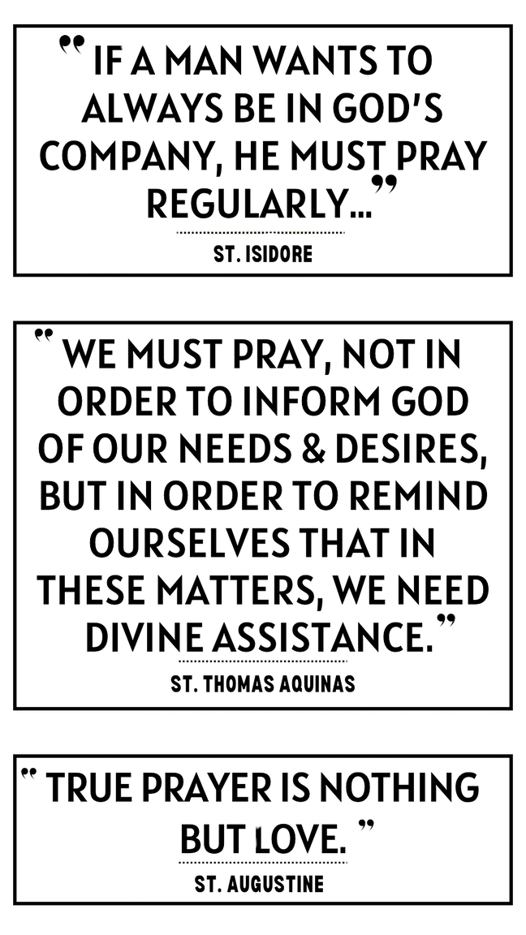
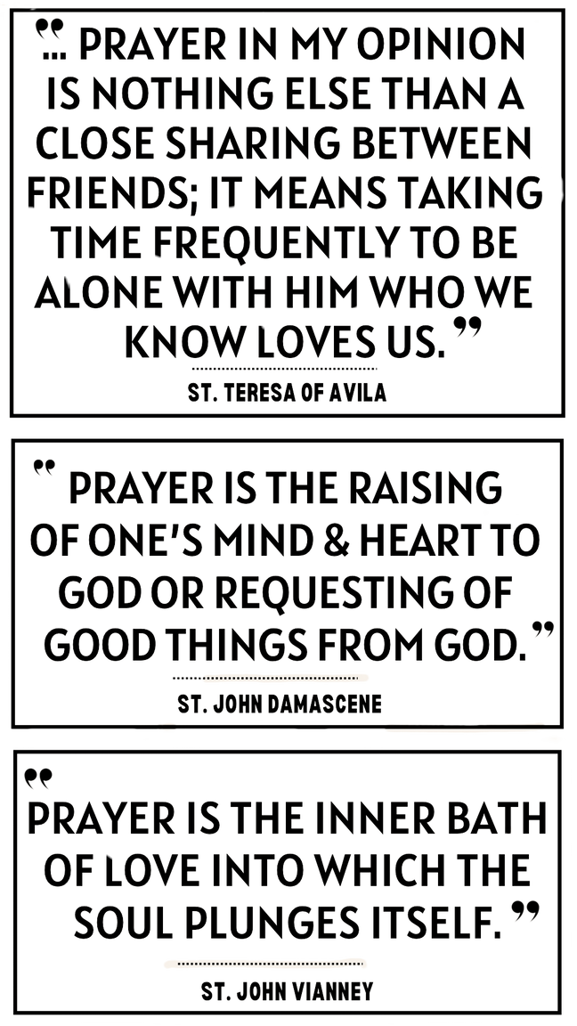
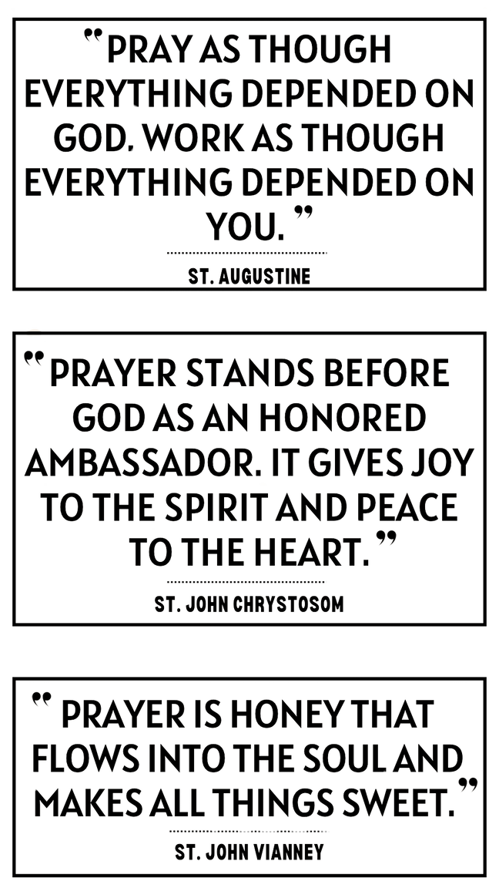
WHAT IS PRAYER?

Slide 4
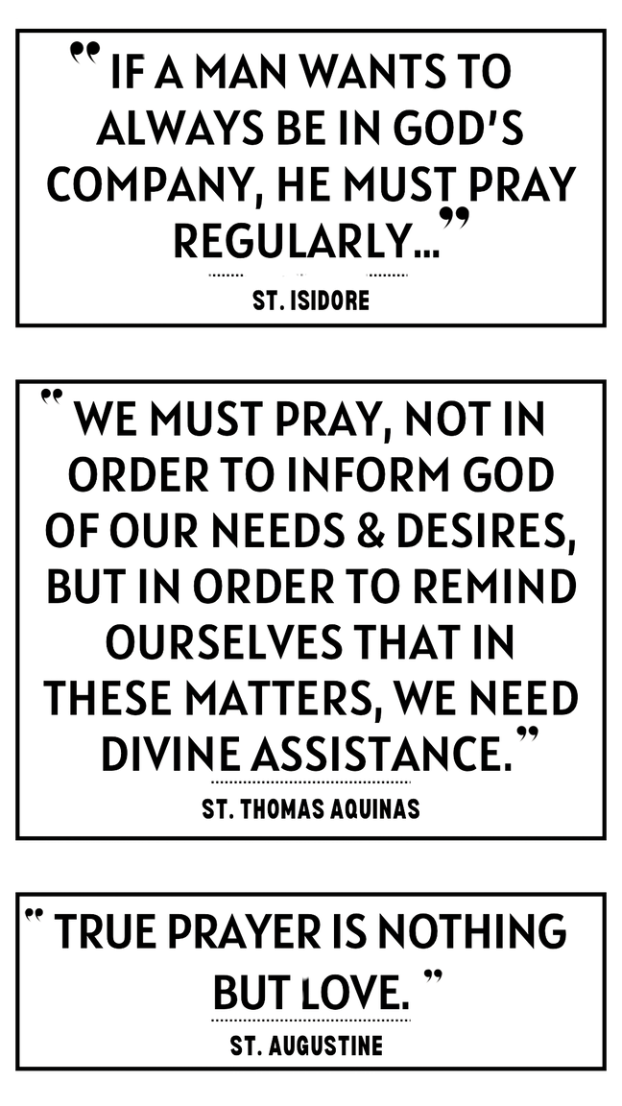
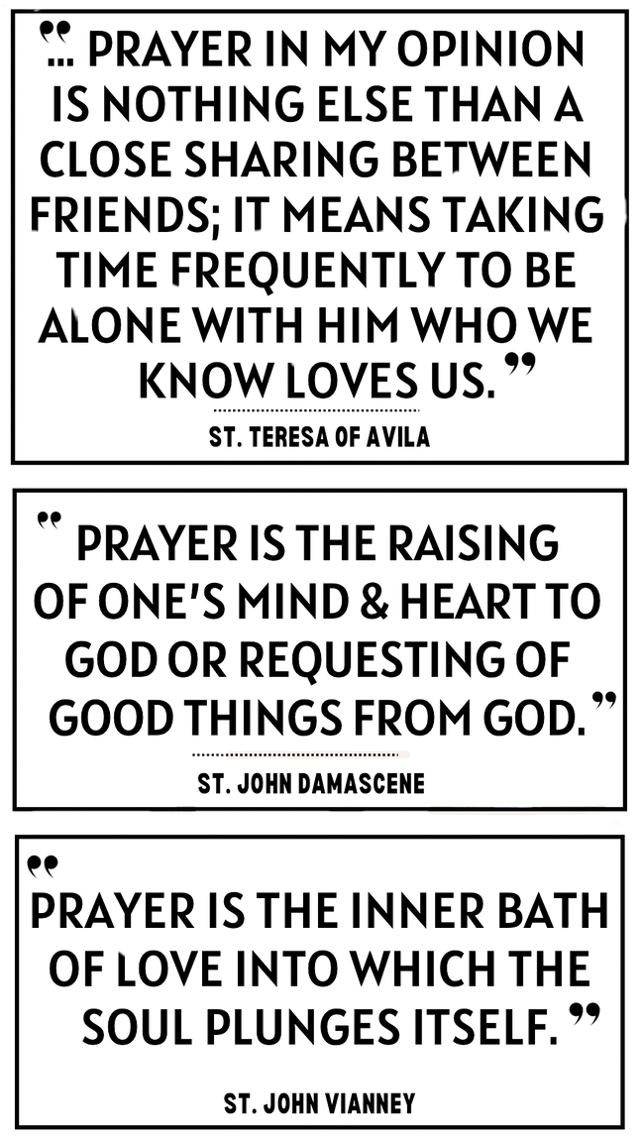
WHAT IS PRAYER?
A TIME IN WHICH WE ENCOUNTER GOD.
Responding to God
Rest in God’s presence
Praise God
Intercede/Pray on the behalf of someone
Meditate on our salvation
Thank God
Ask God for things
Meditate/Reflect on God’s movements in our lives
BUILDING UP & ENGAGING IN A RELATIONSHIP WITH GOD
THROUGH A LONG, LOVING LOOK AT EACH OTHER

Slide 5
WHAT IS PRAYER?
  Rote prayers
    Our Father, Hail Mary, Suscipe Prayer, the Jesus Prayer
  Conversation with God
  Devotionals
    Rosary, Lectio Divina, Divine Mercy Chaplet, Stations of the Cross, Adoration, Consecrations, venerations of relics, Examen
  Adoration, Petition, Intercession, Thanksgiving, Praise
    Ways of praying
  Vocal Prayer
    Rote/traditional prayers & spontaneous prayer
  Meditation
    Examen, Rosary, Stations of the Cross, Imaginative Prayer, Lectio Divina, Reflective Prayer
  Contemplation
    Centering Prayer

Slide 6
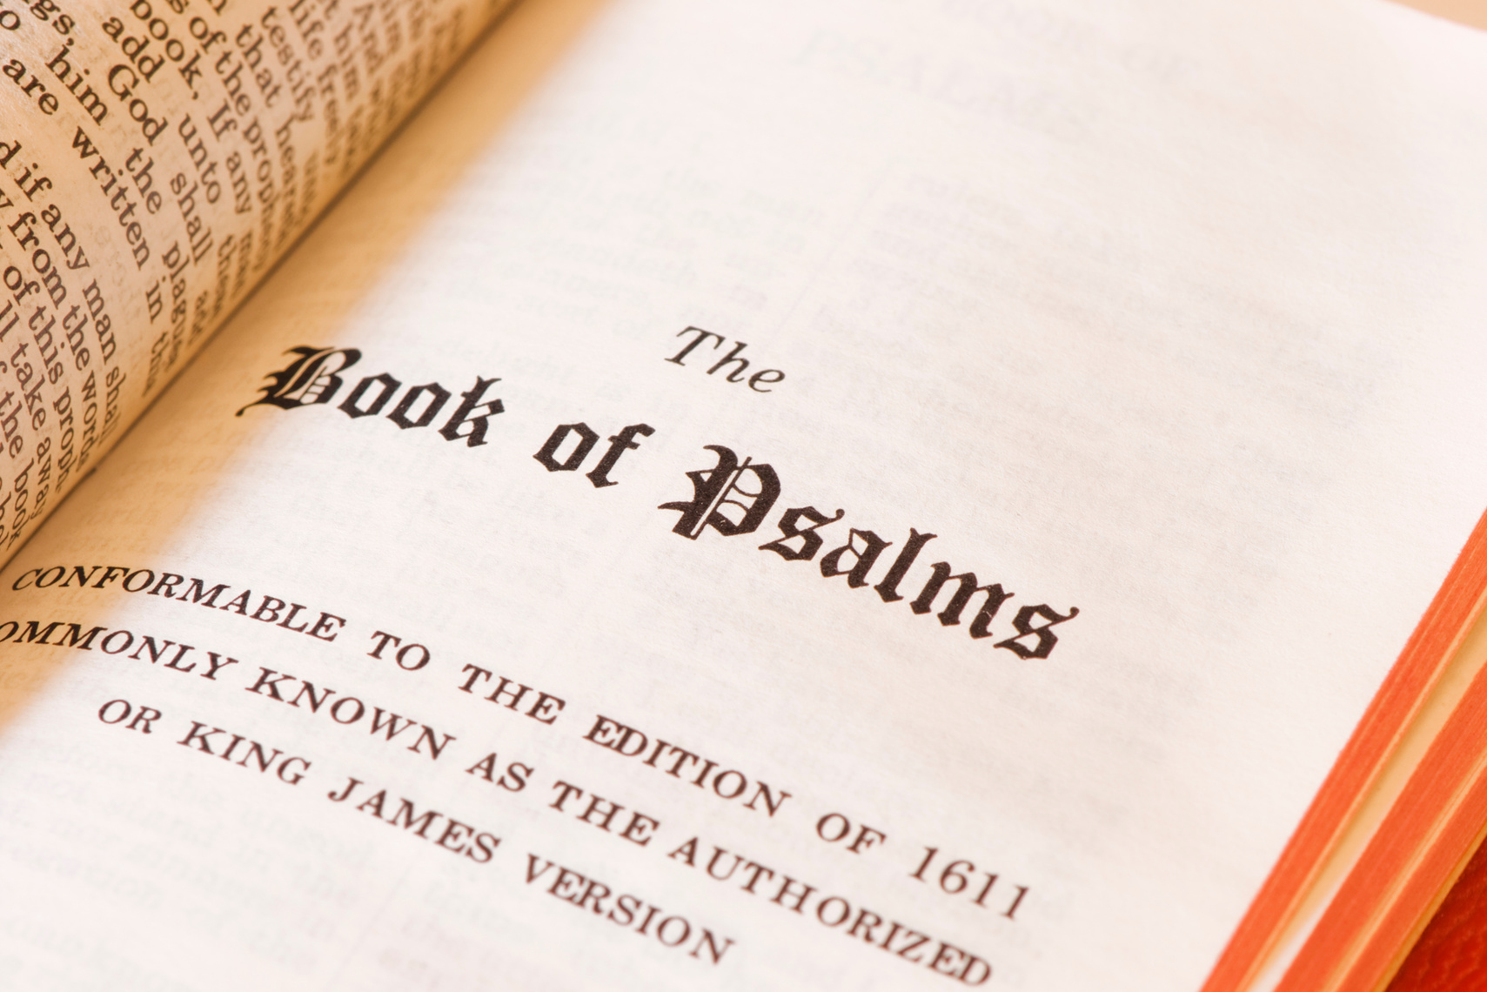
THE PSALMS
  Shows us how to pray & enables/ teaches us how to approach God
  Help us to lift up our hearts to the Lord
  Teach us that there is no pit that the love of God is not present
  Sense of interior movement
  Christ and the Psalms
    In Jesus Christ, the Psalms become flesh
      Words & acts of Christ
“IF THE PSALM PRAYS, YOU PRAY; IF IT LAMENTS, YOU LAMENT; IF IT EXULTS, YOU REJOICE; IF IT HOPES, YOU HOPE; IF IT FEARS, YOU FEAR. EVERYTHING WRITTEN HERE IS A MIRROR FOR US.”
~ST. AUGUSTINE

Slide 7
THE MASS/LITURGY
  Prayer and Liturgy is at the heart of the Catholic faith-filled life
  Mass is one huge prayer, seeped in the Word of God, Tradition, and ultimately culminates in our reception of God through the a sacrament (The Eucharist)
  The mass is not just any experience of prayer
    It is not something that is all about us or any particular religious group
    Consists of the Body of Christ
  A prayer of the total body
    Use of all of your senses: sight, smell, sound, touch, taste
    Has a certain restraint
      Don’t give ourselves entirely over to our passions/beat of the drums
      We are invited into a space of contemplation where our affections arise, but we aren’t forced into it
    Postures/actions we assume during Mass have purpose
  Mass slowly forms us into a life of prayer
    Self-sacrificial love of God

Slide 8
TYPES OF PRAYER
VOCAL
MEDITATIVE
CONTEMPLATIVE
  Most common type of prayer
  Out loud in a group, on our own, or in the silence of our minds
  Rote prayers
    Standardized form of prayer
    Creates sense of unity and continuity
  When you rest completely in the presence of God, letting go of your imagination, thoughts and emotions
  When you simply rest and look at God and He looks back at you, in love
  Hardest form of prayer
  When you speak to God from your own heart
  Focus mind on God and on the way he moves throughout your life
  Some examples: Rosary, Imaginative Prayer, Examine, Lectio Divina, Divine Mercy Chaplet

Slide 9
WITHIN VOCAL PRAYER...
6 EXPRESSIONS OF PRAYER
Blessing
Intercession
Adoration
Thanksgiving
Petition
Praise

Slide 10
HOW DO WE PRAY?
Remember:
Prayer is about encountering with God and building up our relationship with Him
  Prayer is communal and personal
  Sometimes it takes 5 min or 30 secs to align our hearts to Christ
  Use the tools that God has given us to grow in relationship with God
  Technique cannot just be the only way to pray
  Prayer is not an obligation, but a moment for transformation
  Prayer is just simply us reaching out to God; not just through words
  Prayer is a launching of ourselves to Christ
  If we are people of faith, we are people of prayer: prayer does not have to be perfect, just has to be authentic (and to be with God)
  Set meeting with God
    Never miss your meetings; build time in schedule & routine to “meet with God”

Slide 11
HOW DO WE PRAY?
  Some Examples of Devotionals
    Rosary
    Divine Mercy Chaplet
    Lectio Divina
    Litanies
    Novenas
    Divine Office/Liturgy of the Hours
    Imaginative Prayer
    The Lord’s Prayer
    Stations of the Cross
    Frameworks of Prayer
      TRIP (Thanksgiving, Reconciliation, Intercession, Personal)
      ACTS (Adoration, Contrition, Thanksgiving, Supplication)
      ARRR (Acknowledgement, Relate, Receive, Respond in Gratitude)

Slide 12
SEASONS OF PRAYER
YOUR DIFFERENT MOODS : YOUR SEASON OF PRAYER
DIVERSITY OF PRAYER CAN HELP YOU GROW, SPIRITUALLY
LIZ’S PRAYER TIMELINE:
Angelus/Biblical Imagination/Visio Divina
Contemplation
Adoration
Mass
Prayers of Intercessions
Lectio Divina
Adoration / Meditation
Angelus / Rosary

Slide 13

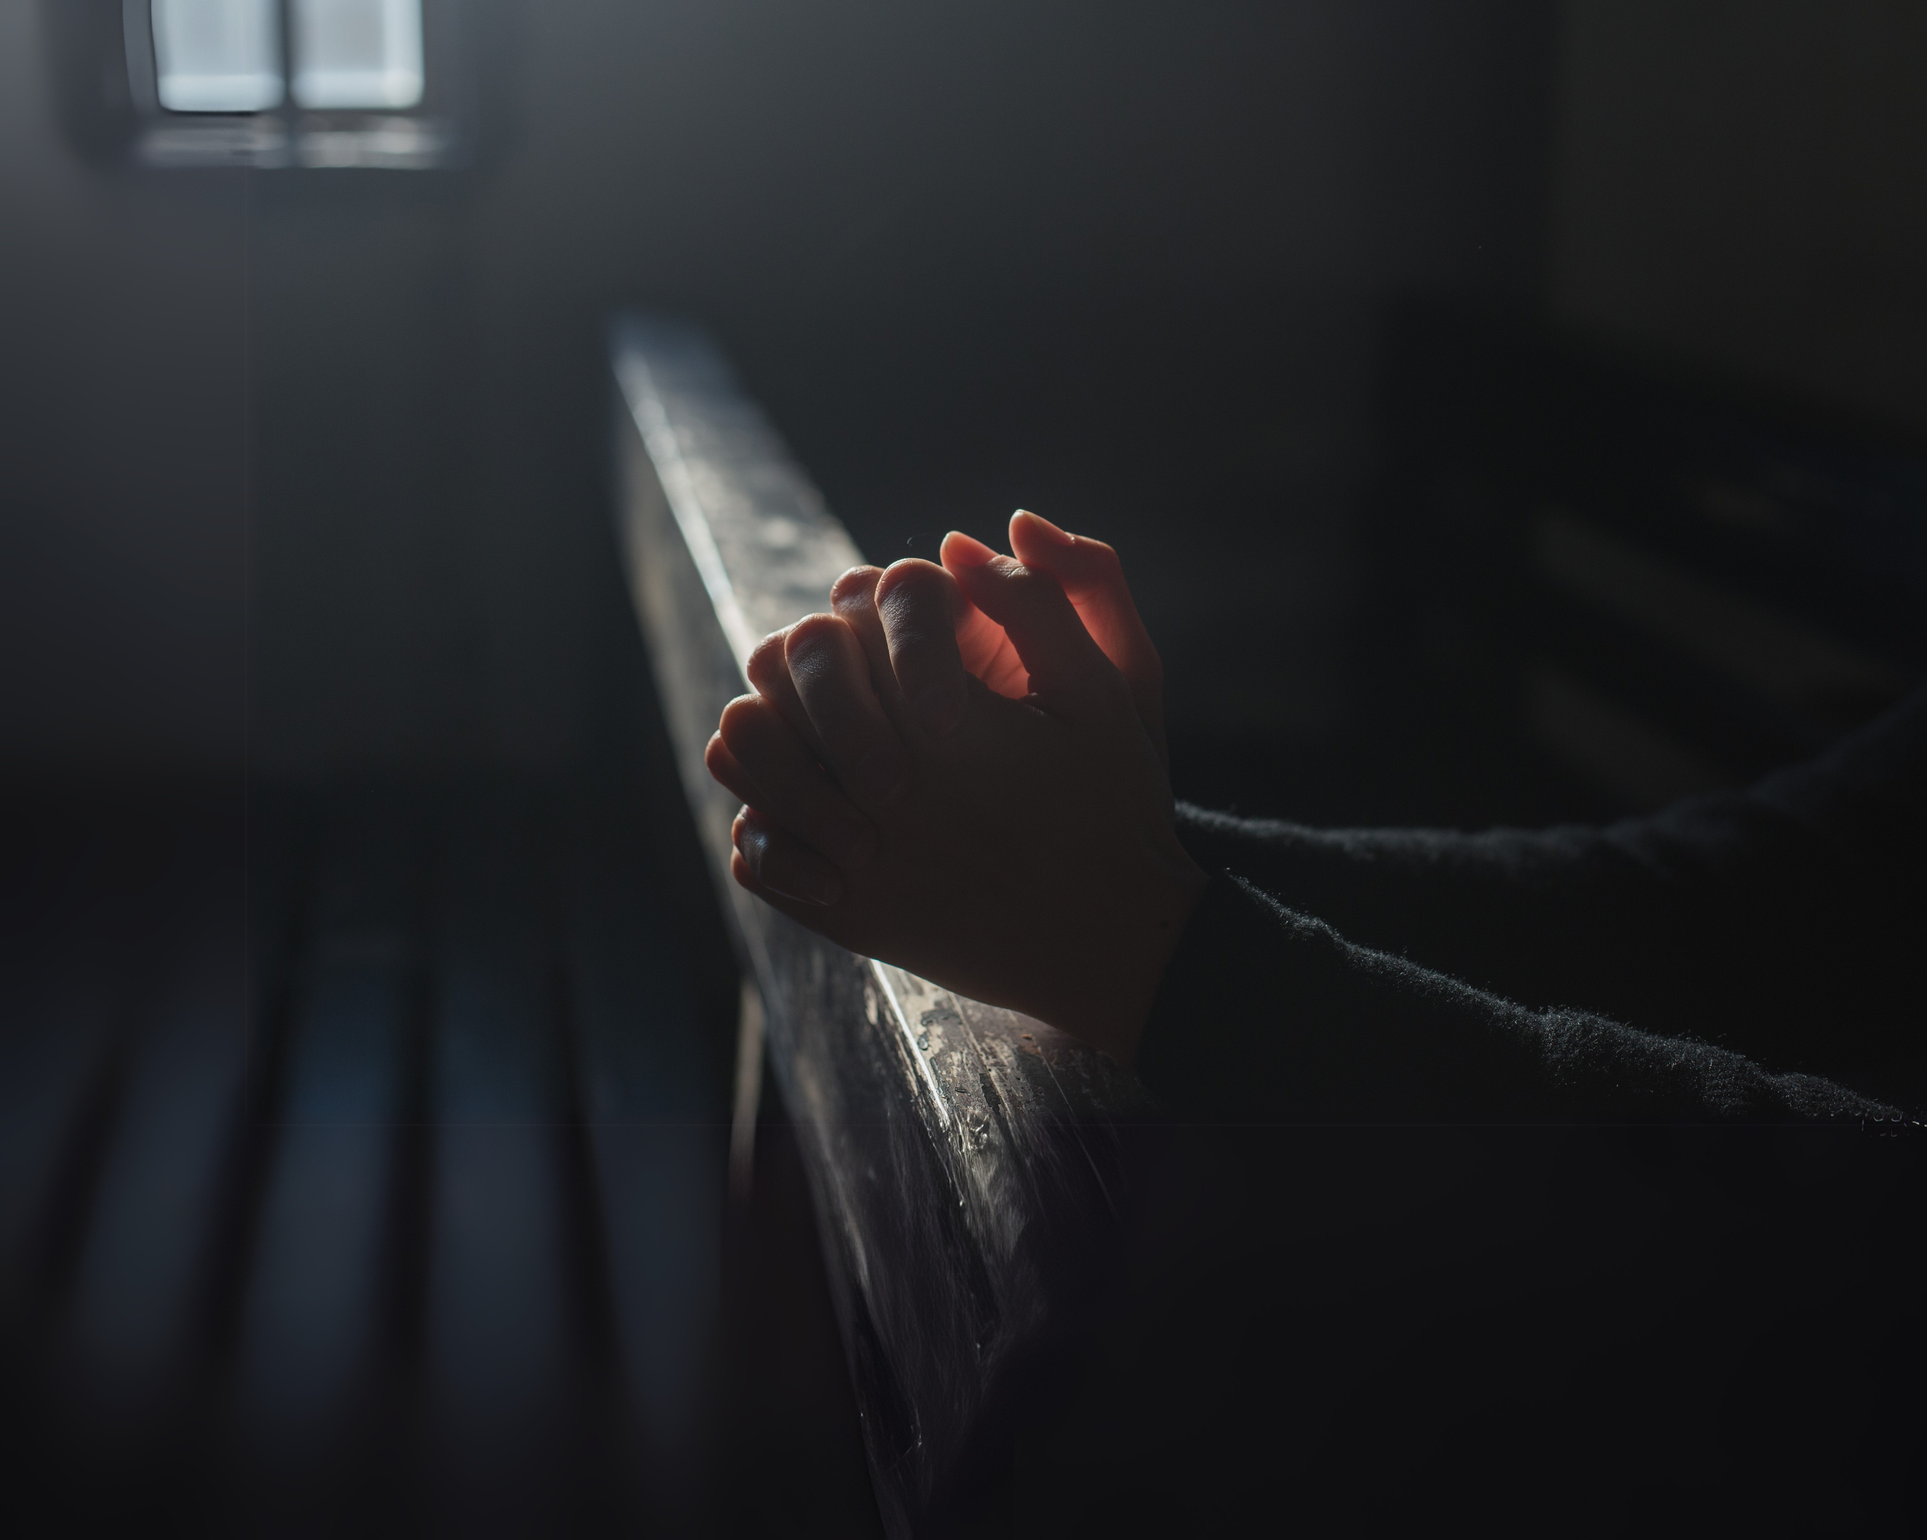
THE BEST WAY TO PRAY IS
YOUR BEST WAY TO PRAY
It has to be out of love, not obligation
“Everyone of us needs half an hour of prayer each day, except when we are busy – then we need an hour.”
- St. Francis de Sales

