Slide 1
Sacraments of Initiation
O.C.I.A.
“Order of Christian Initiation for Adults”

Slide 2
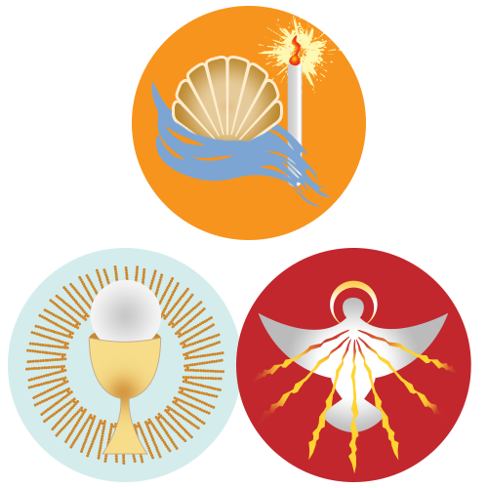
What are the Sacraments of Initiation?
Baptism
Confirmation
Holy Eucharist

Slide 3
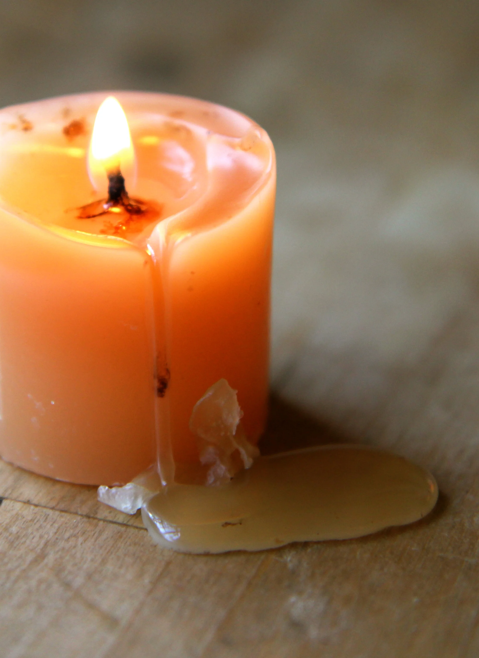
Our hearts have to melt so we can be reformed

Slide 4
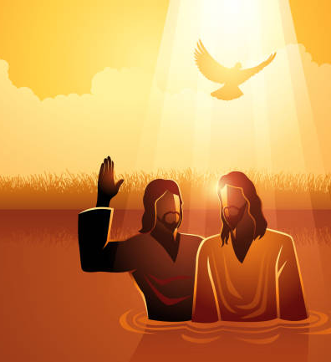
Baptism
“No one can enter the Kingdom of God without being born of water and Spirit.”
– Jn. 3:5

Slide 5

Confirmation
"In him you also, when you had heard the word of truth, the gospel of your salvation, and had believed in him, were marked with the seal of the promised Holy Spirit." —St. Paul

Slide 6
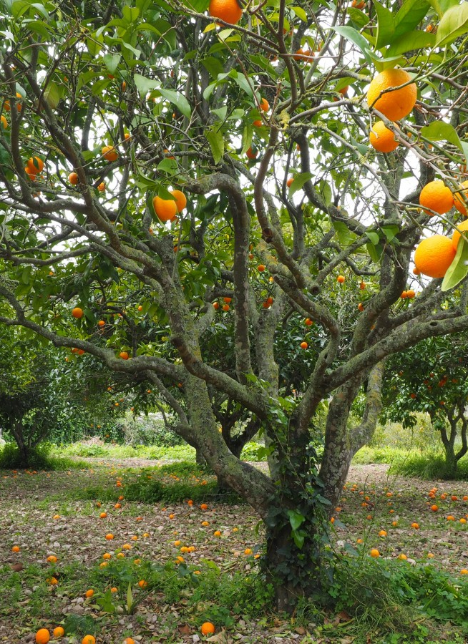
How do we experience the Holy Spirit?
You will know them by their fruits. Are grapes gathered from thorns, or figs from thistles?
–Matthew 7:16

Slide 7

Gifts of the Holy Spirit
FRUITS OF THE HOLY SPIRIT
Wisdom
Understanding
Knowledge
Fortitude
Counsel
Piety (reverence)
Fear of the Lord
Charity
Patience
Generosity
Modesty
Joy
Kindness
Gentleness
Self-control
Peace
Goodness
Faithfulness
Chastity

Slide 8
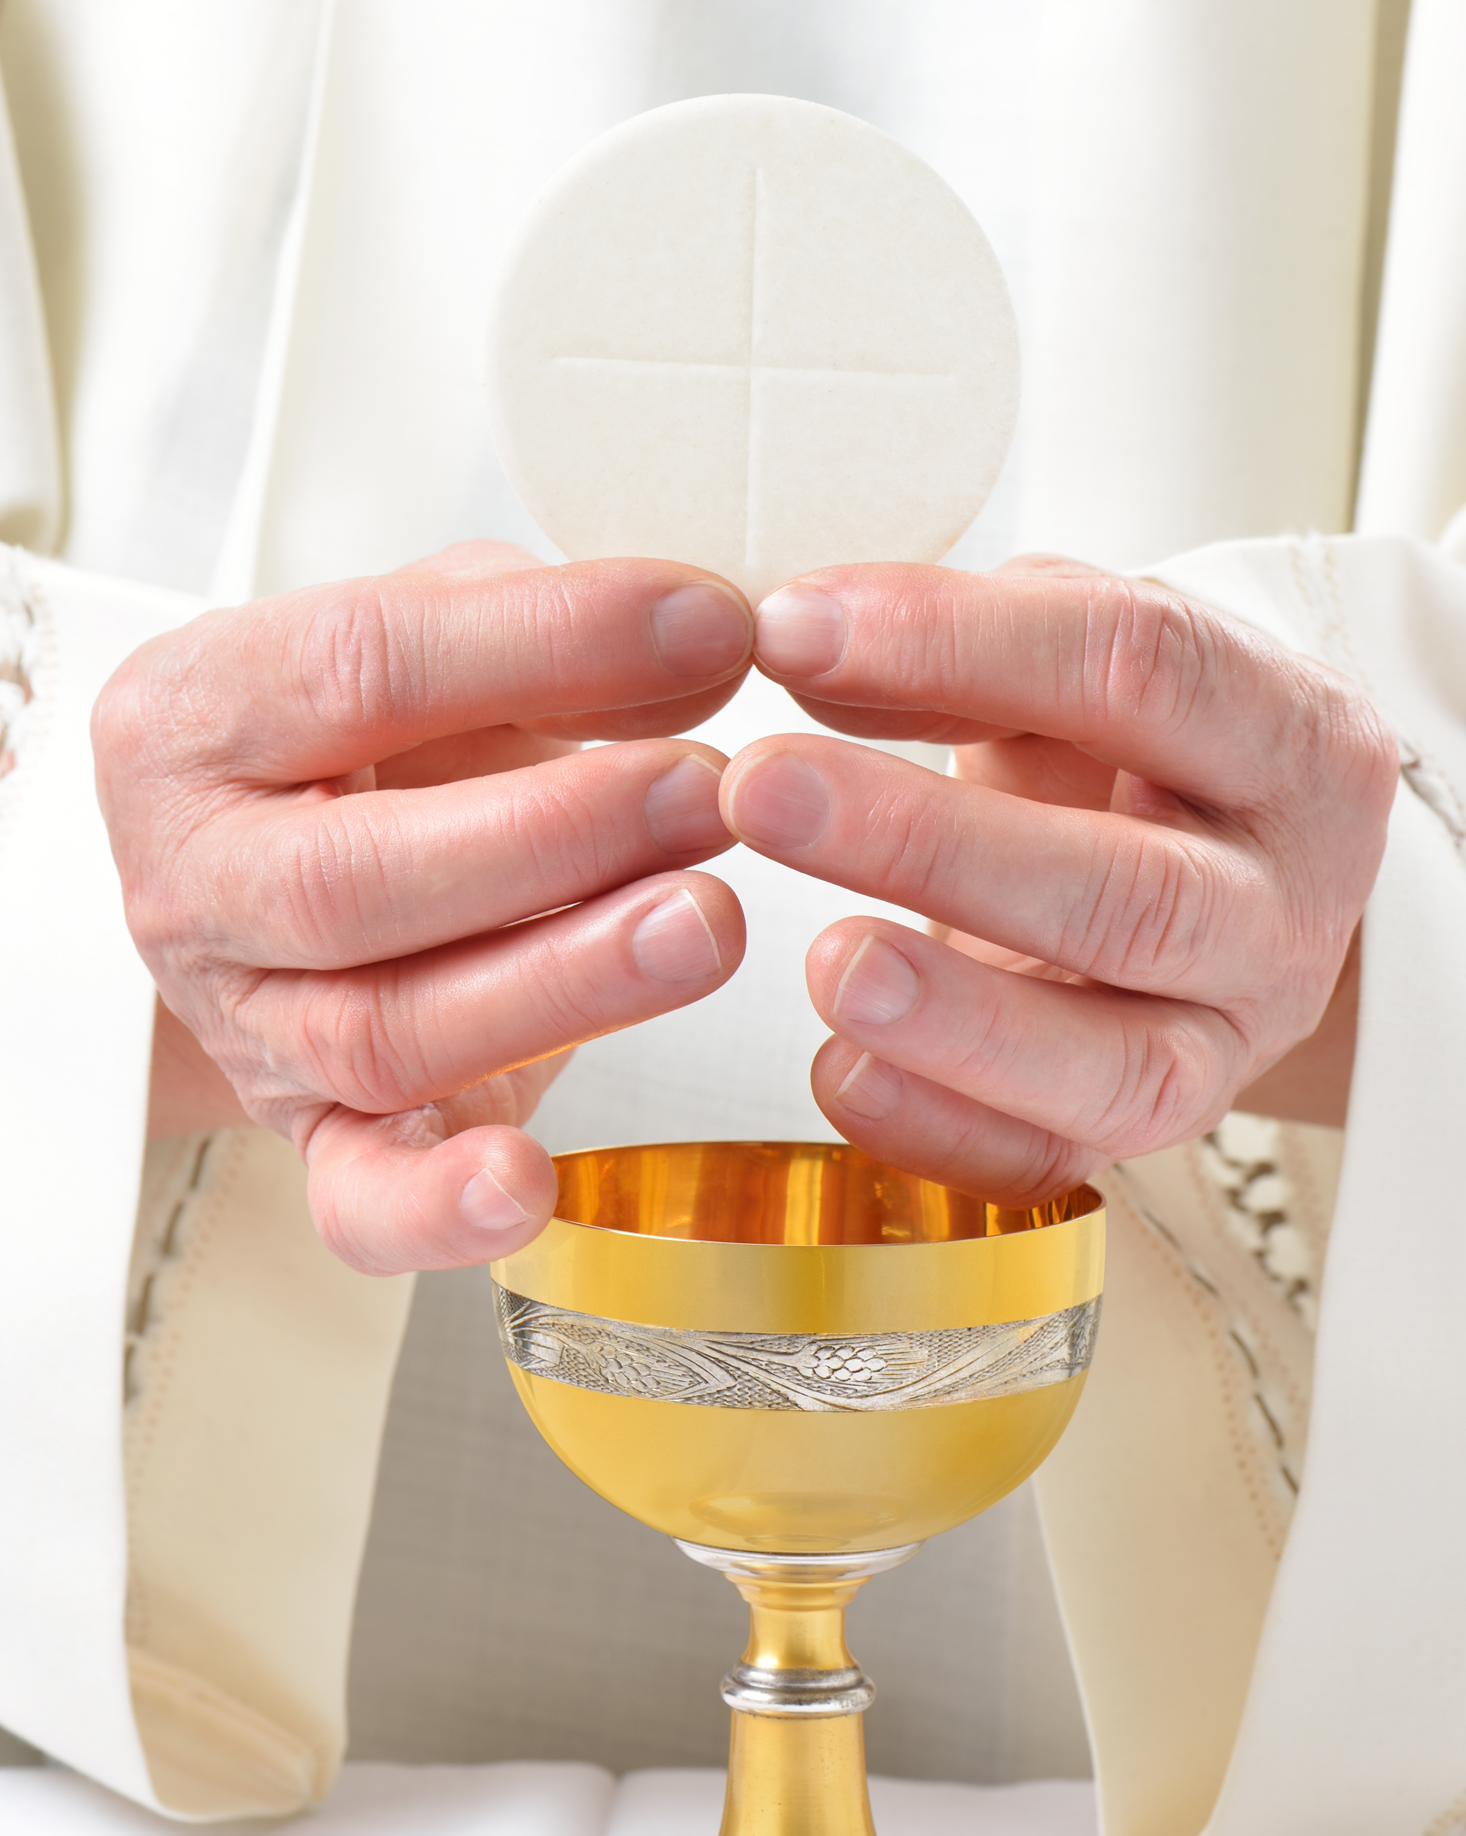
The Eucharist
The Source and Summit of our Faith
“I am the Living bread that came down from heaven… unless you eat the flesh of the Son of Man and drink his blood, you do not have life within you.”
- John 6:51, 53
​

Slide 9
Timeline of the Eucharist
Passover
Exodus 12 – The people of Israel were saved by the blood of the lamb
Melchizedek’s Offering
Genesis 14:18 – Uses bread and wine
Miracle of changing water to wine
Manifested the divine glory of Jesus and the heavenly wedding feast in which we share at every Eucharist
Jesus Institutes the Eucharist
“This is my body…. This is my blood...”
Matt 26:17-29
Mk 14:12-25
Lk 22:7-20
Miracle of the Loaves and fishes
Prefigures the abundance of the Eucharist

Slide 10
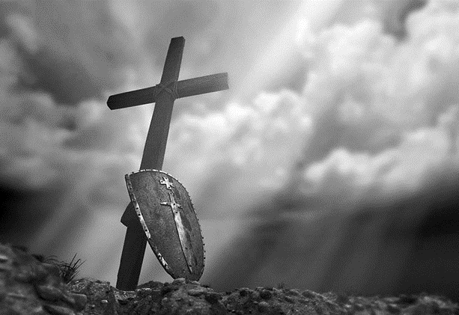
What Do We Do Now?
This is not the finish line – It’s a call to arms!
“Go therefore and make disciples of all nations, baptizing them in the name of the Father and of the Son and of the Holy Spirit, teaching them to observe all that I have commanded you; and lo, I am with you always, to the close of the age.” Mt. 28:18-20
“Those who with God’s help have welcomed Christ’s call and freely responded to it are urged on by love of Christ to proclaim the Good News everywhere in the world…. All Christ’s faithful are called to hand it on from generation to generation, by professing the faith, by living it in fraternal sharing, and by celebrating it in liturgy and prayer.” (CCC 3)
Only a third of Catholics believe in the real presence of Jesus in the Eucharist – let’s change that!

