Slide 1
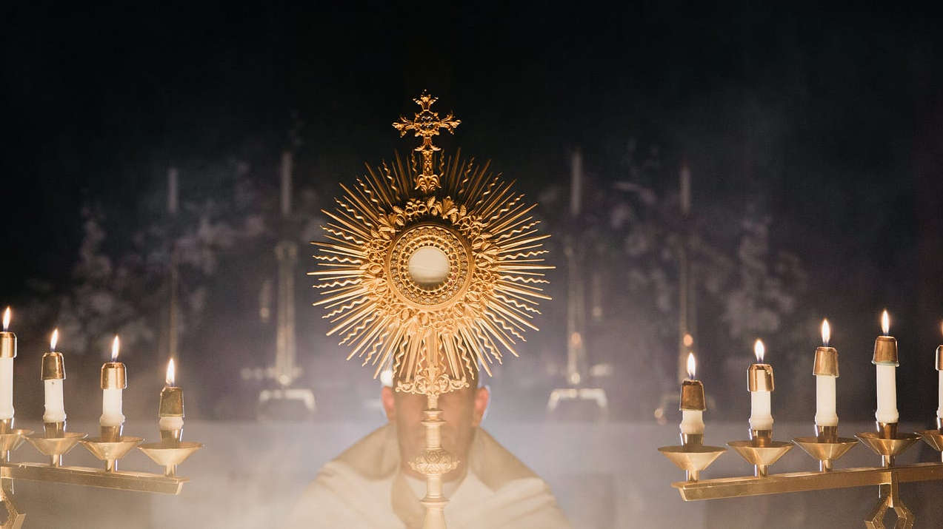
Seven Practical Ways to Live as a Catholic

Slide 2
Acts 2:42
And they continued steadfastly in the apostles teaching and fellowship, in the breaking of bread and the prayers.
These are the four pillars of the Catechism of the Catholic Church

Slide 3
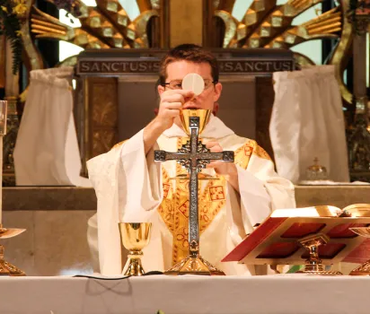
Step One : The Mass
Our journey always starts here.
If we get this right, everything else falls into place.
Ask for God’s help

Slide 4
Acts 2:42
And they continued steadfastly in the apostles teaching and fellowship, in the breaking of bread and the prayers.

Slide 5
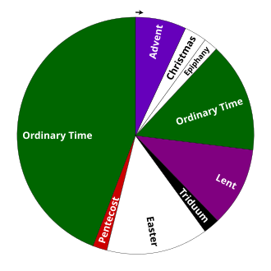
The Liturgical Calendar
This Photo by Unknown Author is licensed under CC BY-SA

Slide 6
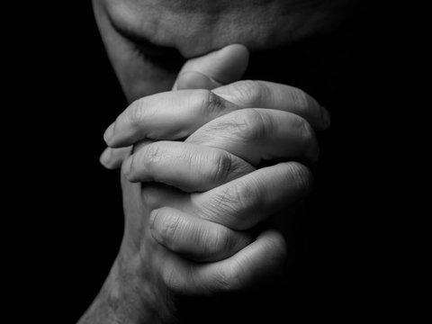
Step Two: Prayer
We need a relationship with God
In prayer, we can bring anything to our Father
We pray for each other
We ask for the prayers of the saints

Slide 7
Acts 2:42
And they continued steadfastly in the apostles teaching and fellowship, in the breaking of bread and the prayers.

Slide 8
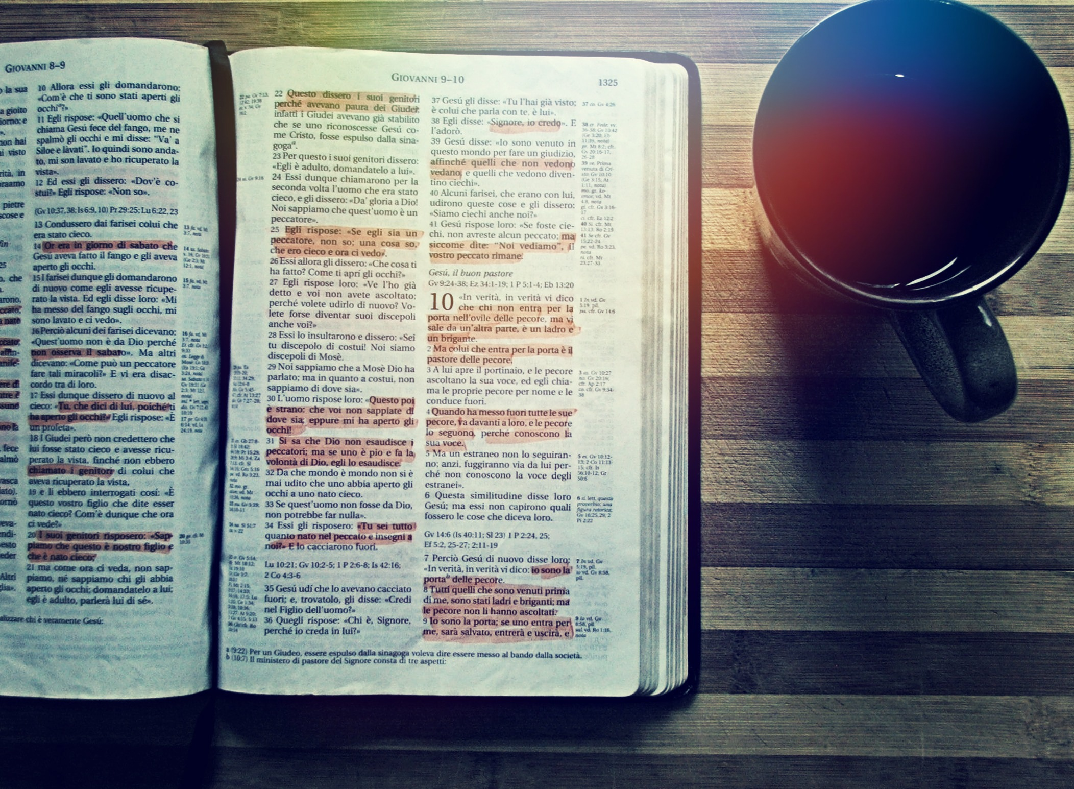
Step three: Scripture
This is how God speaks to us
The Bible is our love-note from God

Slide 9
Acts 2:42
And they continued steadfastly in the apostles teaching and fellowship, in the breaking of bread and the prayers.

Slide 10
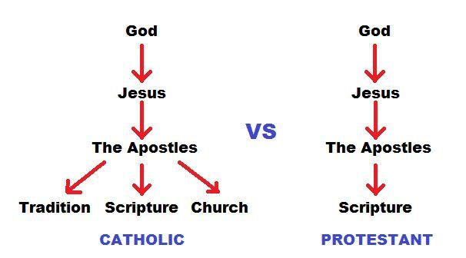

Slide 11

Highly recommend finding a study guide to read the Bible

Slide 12
Catholic books that are not in a protestant bible
Judith
Tobit
Baruch
Wisdom
Sirach
1 Maccabees
2 Maccabees

Slide 13
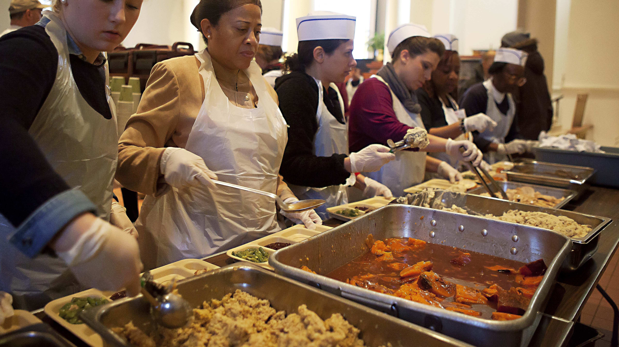
Step four: Service

Slide 14
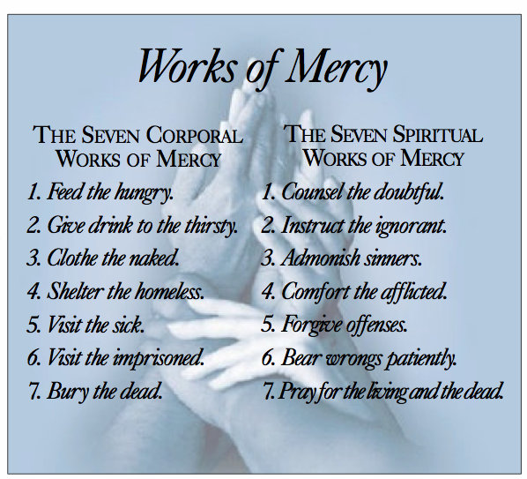
The corporal and spiritual works of mercy

Slide 15

Step five: Sharing

Slide 16
Acts 2:42
And they continued steadfastly in the apostles teaching and fellowship, in the breaking of bread and the prayers.

Slide 17
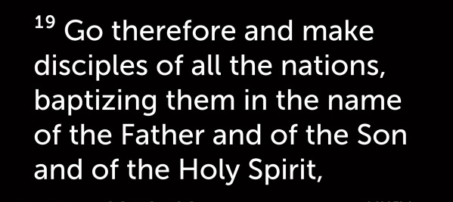

Slide 18

Step six: gratitude
This Photo by Unknown Author is licensed under CC BY-NC-ND

Slide 19

Step seven: be Joyful!
We are a resurrection people!
Jesus conquered the grave and that is reason to be happy!!!
This Photo by Unknown Author is licensed under CC BY-NC-ND

Slide 20
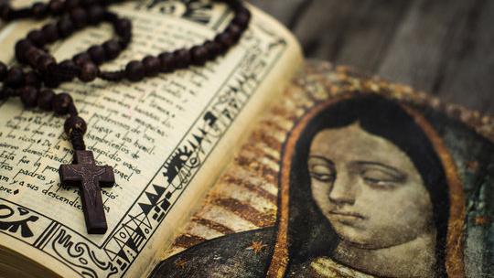
Bonus: This will change how you live your life!

