Slide 1
The Holy Trinity

Slide 2
https://youtu.be/KQLfgaUoQCw?feature=shared

Slide 3
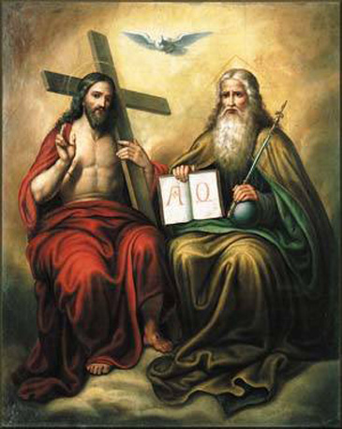
The Trinity
Not made by man, but revealed by God
Essential to our faith CCC 234
Sign of the Cross

Slide 4
What the Trinity is not
Not three separate gods (tritheism)
Not three parts of one God (partialism)
Not simply different roles or modes (modalism)
Not an abstract or impersonal force
Not solitary or isolated

Slide 5

Why Can’t we see God?
Our ability to perceive God is limited by our point of view
Illustration of 2D vs 3D perception
So then how do we see God?

Slide 6
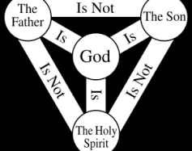
The Trinity Triangle

Slide 7
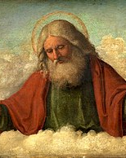
God The Father
Elohim -> YHWH
Uncreated creator
Almighty
Wise
Love

Slide 8
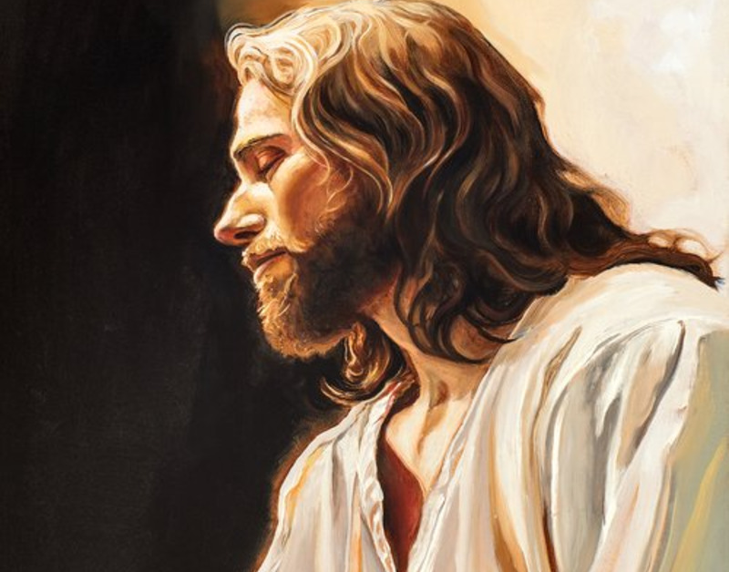
God The Son
Dabar
The Word – Jn. 1:14
Image – Col. 1:15
“Begotten not made”
Wisdom of God
Hypostatic Union – Fully God and Fully Man

Slide 9
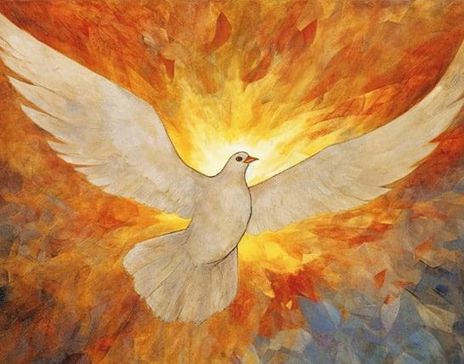
God The Holy Spirit
Ruah
Breath of God
Mutual love
The Counselor – Jn 14:26
Spirit of Truth – Jn 16:13
Cloud
Fire
Dove

Slide 10
The trinity through relationship
Every “being” at all levels can communicate or make an image of itself.
The higher you go, the more perfect and interior this process of communication becomes

Slide 11
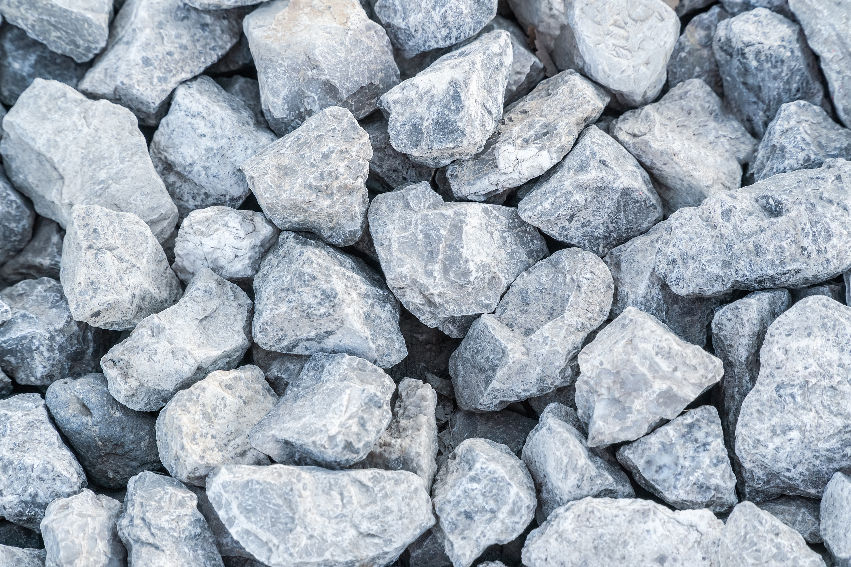
ROCK. Lowest level.

Slide 12

PLANT. Higher level.

Slide 13

ANIMALS. Higher still

Slide 14
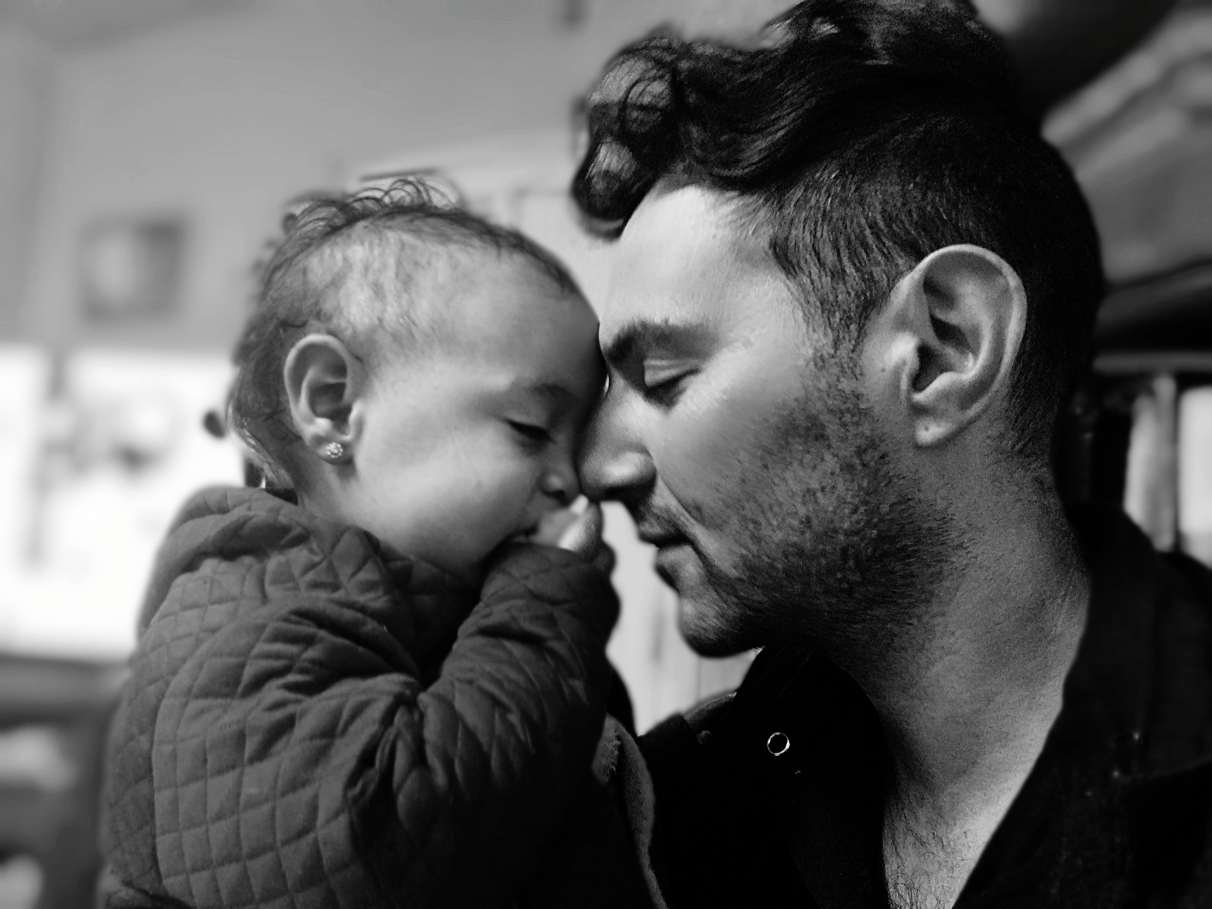
HUMANS. Higher Still.

Slide 15

OAKLEY. We’re stepping back a minute.

Slide 16
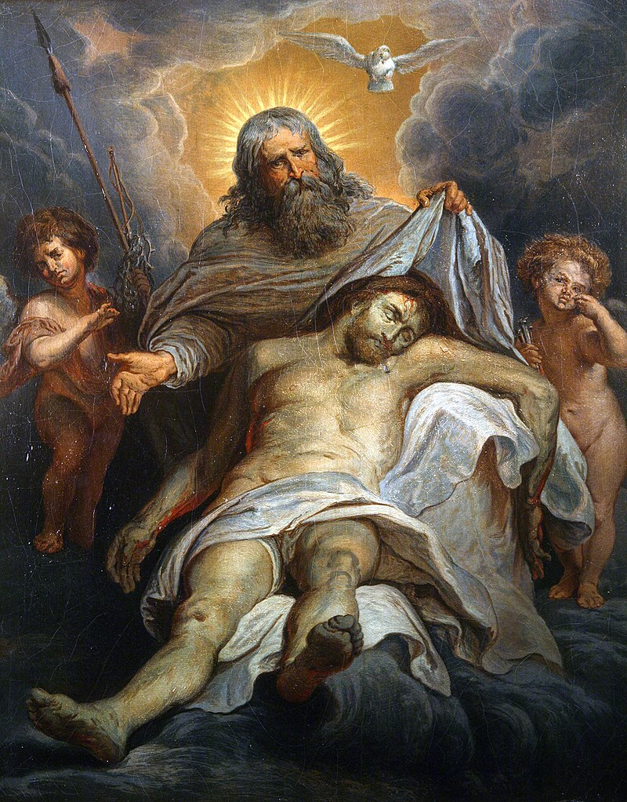
GOD. Highest Level.

Slide 17

Why does this matter?
It matters because God is communal
God is relationship
It matters because God so loved the world…
This is why we love our neighbors
Not Works vs Grace
Our FAITH is about relationship

