Slide 1
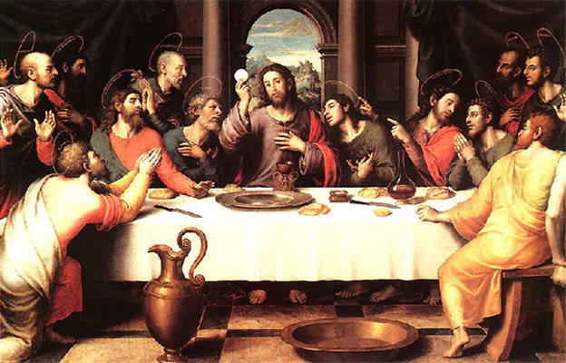
The Communion Rite
1
The Communion Rite

Slide 2
Review
2
Introductory Rite – sign of the cross, Greeting, “I confess”, Lord, Have Mercy, Gloria and collect
Liturgy of the Word – First reading, responsorial psalm, second reading, Gospel, Homily, Creed, Prayer of the Faithful
Liturgy of the Eucharist – Presentation of gifts, Water + wine, washing of hands, Prayer over offerings
Eucharistic Prayer – Preface, Holy Holy Holy, Epiclesis, Words of Institution and consecration, The mystery of Faith, The Anamnesis, offering, intercessions and final doxology

Slide 3
The Liturgy of the Eucharist and Concluding Rite

Slide 4
The Communion Rite
4
The Lord’s Prayer
The Rite of Peace
The Agnus Dei

Slide 5
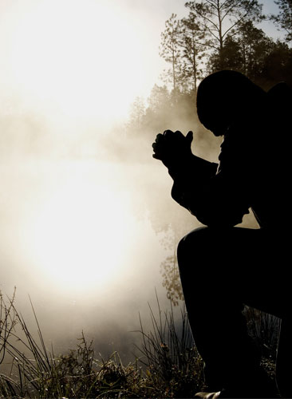
The Lord’s Prayer
“ At the Savior’s command
and formed by divine teaching,
we dare to say…”
This Photo by Unknown Author is licensed under CC BY-SA-NC

Slide 6
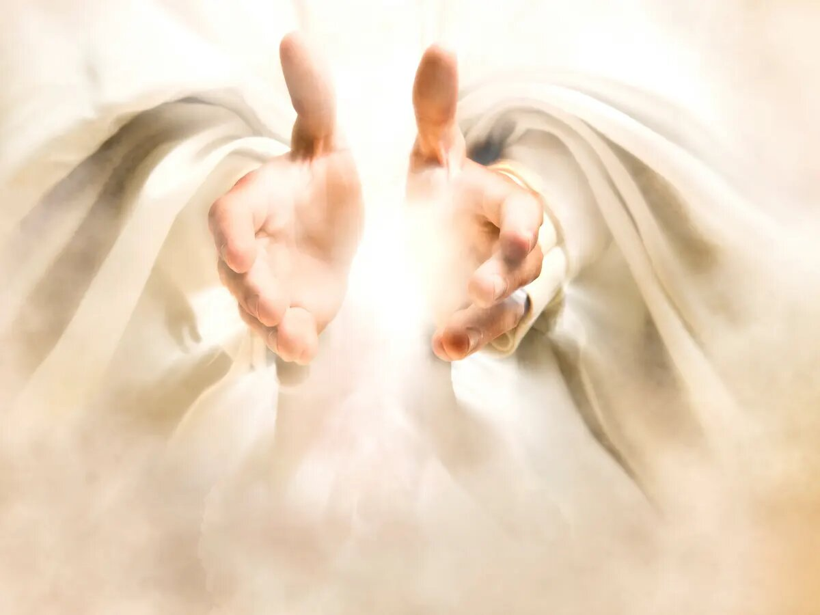
What does it mean when we call the Father “Ours”?
We do this as His children, not individualistically
Jesus invites us to be close to His Father
“Abba” = “Daddy”
We struggle with this intimacy

Slide 7
The Seven Petitions
7
Hallowed be thy name
Thy kingdom come
Thy will be done on earth as it is in heaven
Give us this day our daily bread
Forgive us our trespasses as we forgive those who trespass against us
Lead us not into temptation
Deliver us from evil

Slide 8
“Deliver us, Lord, we pray, from every evil, graciously grant peace in our days, that, by the help of your mercy, we may be always free from sin and safe from all distress, as we await the blessed hope and the coming of our Savior, Jesus Christ.”
“Then I heard every creature in heaven and on earth and under the earth and on the sea, and all that is in them, saying: ‘To him who sits on the throne and to the Lamb be praise and honor and glory and power, for ever and ever!”
“Blessed are you O Lord, the God of Israel our father, for ever and ever. Yours, O Lord, is the greatness, and the power, and the glory, and the victory, and the majesty; mfor all that is in the heavens and in the earth is yours; yours is the kingdom, O Lord, and you are exalted as head above all.” – 1 Chronicles 29:10-11
“For the Kingdom, the Power and the Glory are yours now and for ever.”

Slide 9

The Rite of Peace
“Lord Jesus Christ, who said to your Apostles, Peace I leave you, my peace I give you, look not on our sins, but on the faith of your Church, and graciously grant her peace and unity in accordance with your will….”
“The peace of the Lord be with you always.”

Slide 10
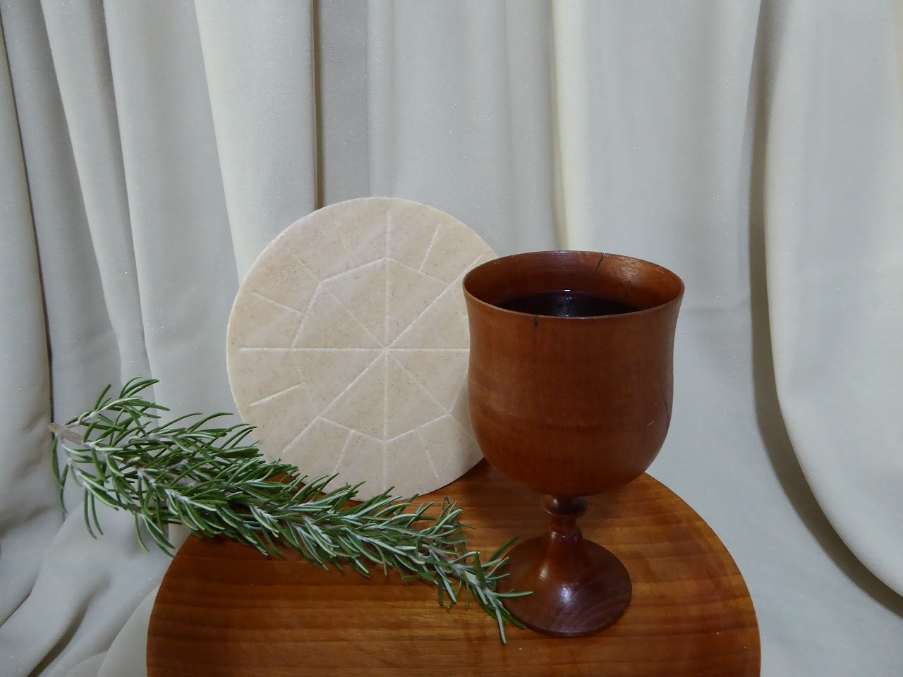
Agnus Dei: The Fraction, Commingling, and “Lamb of God”
The Breaking of the bread
The commingling of the Body and Blood of Christ
The recitation of the “Lamb of God” prayer

Slide 11
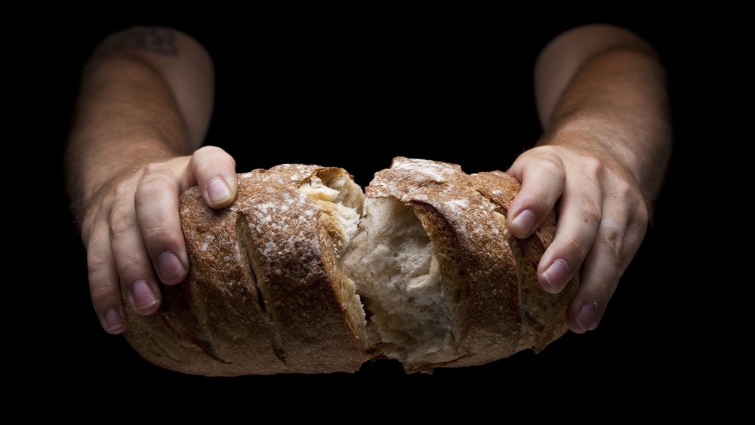
The Fraction

Slide 12
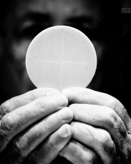
Commingling

Slide 13
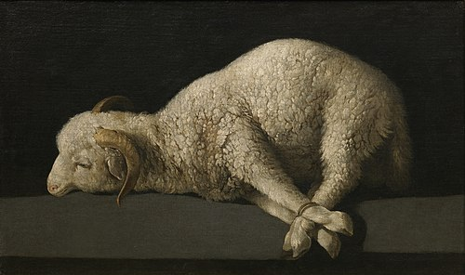
The Agnus Dei
“ Lamb of God, you take away the sins of the world, have mercy on us.
Lamb of God, you take away the sins of the world, have mercy on us.
Lamb of God, you take away the sins of the world, grant us peace. ”

Slide 14
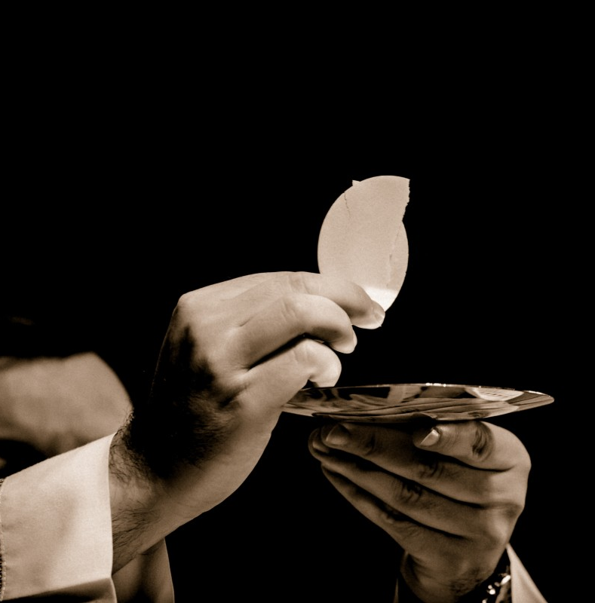
Holy Communion
“Behold the Lamb of God, behold him who takes away the sins of the world. Blessed are those called to the supper of the Lamb.”

Slide 15
Passover
Hallel Psalms
Hallel Psalms
Revelation
The
Lamb
The Mass

Slide 16
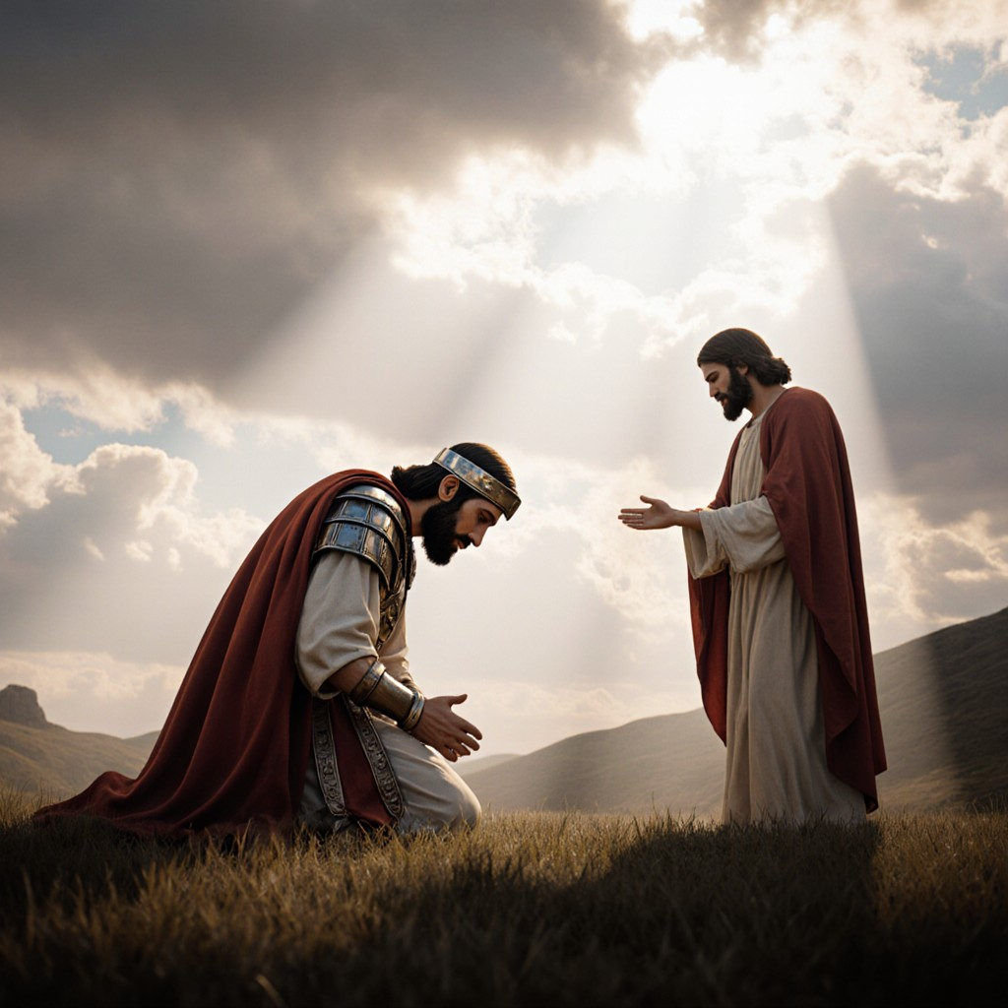
Approach with HUMILITY
“Lord, I am not worth that you should enter under my roof, but only say the word and my soul shall be healed.”

Slide 17

GO FORTH!

